Slide 1
LONDON INSTITUTE OF SPACE POLICY AND LAW
SPACE POLICY AND LAW COURSE
ON-LINE
9 to 11 November 2020
COMMERCIAL SPACE ACTIVITIES
Professor Steven Freeland
Western Sydney University, ISPL Senior Fellow
Donna Lawler
Azimuth, ISPL Faculty

Slide 2
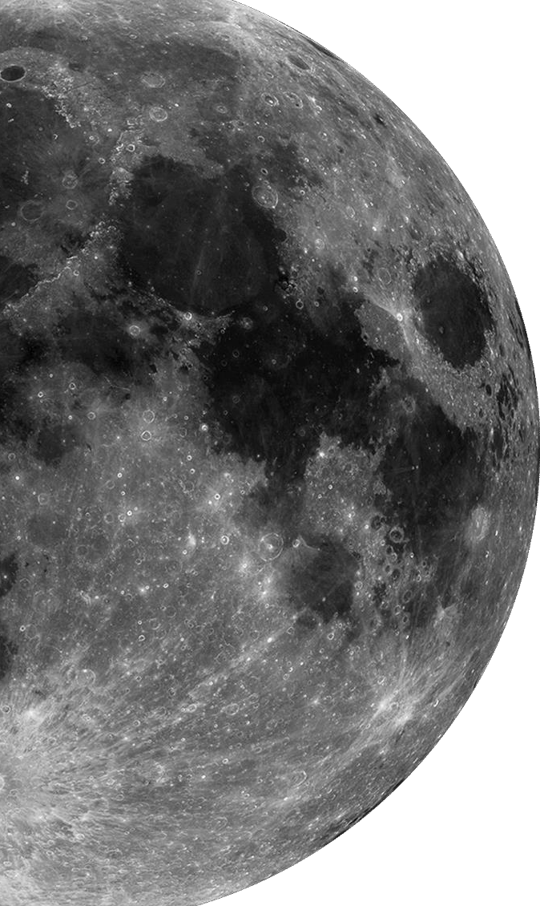

Commercial Space Activities
1
Current activities in Commercial Space
2
₃ Space missions: what could possibly go wrong? How do contracts manage risks in space.
4
Space as a unique legal environment
Purchasing spacecraft
5
Launching spacecraft
6
Guiding principles for future regulation
2

Slide 3
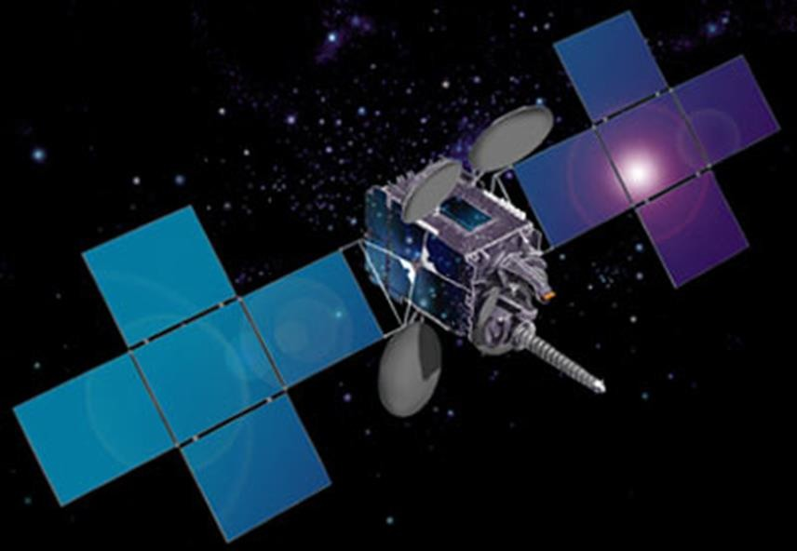
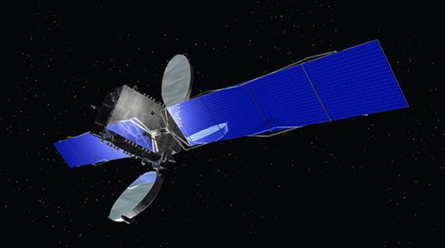


What’s happening in Commercial Space? Space 1.0

Slide 4

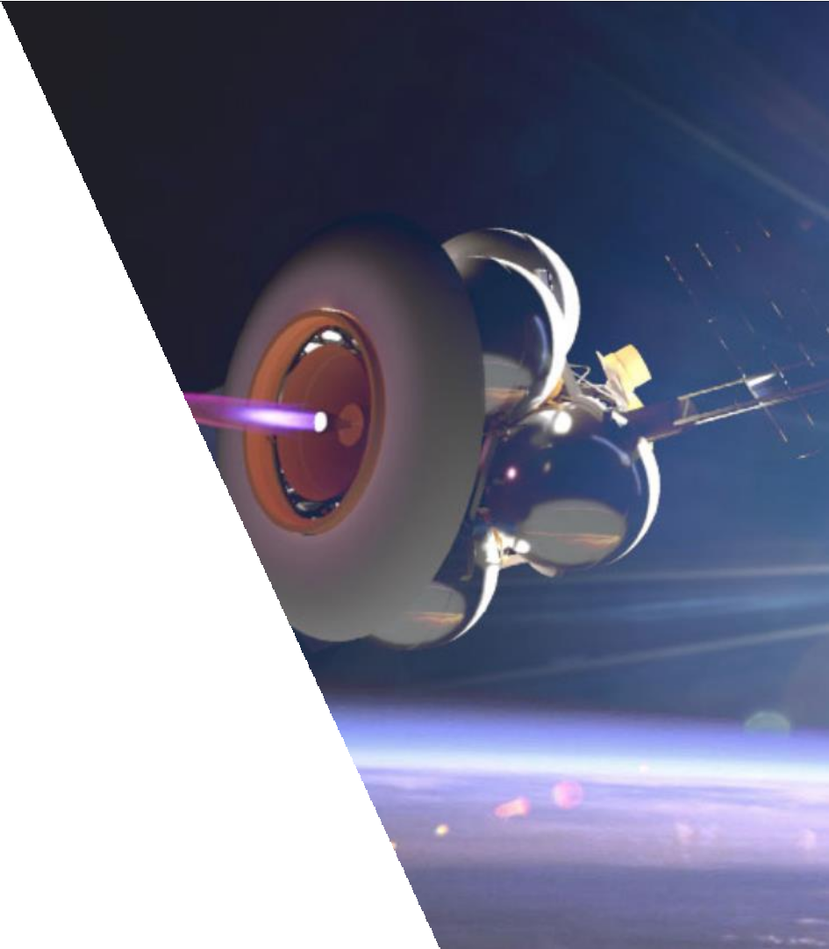
Current activities in space
Launch facilities
Launch vehicles
Geostationary Communications Satellites
Precision Navigation & Timing applications (SBAS)
Constellations of small satellites in low earth orbit
Remote sensing of earth from space
Imaging of space objects from space
Orbital transfer services
In-orbit servicing of satellites
In orbit manufacturing
Off earth mining (and related swarm AI technologies)

Slide 5
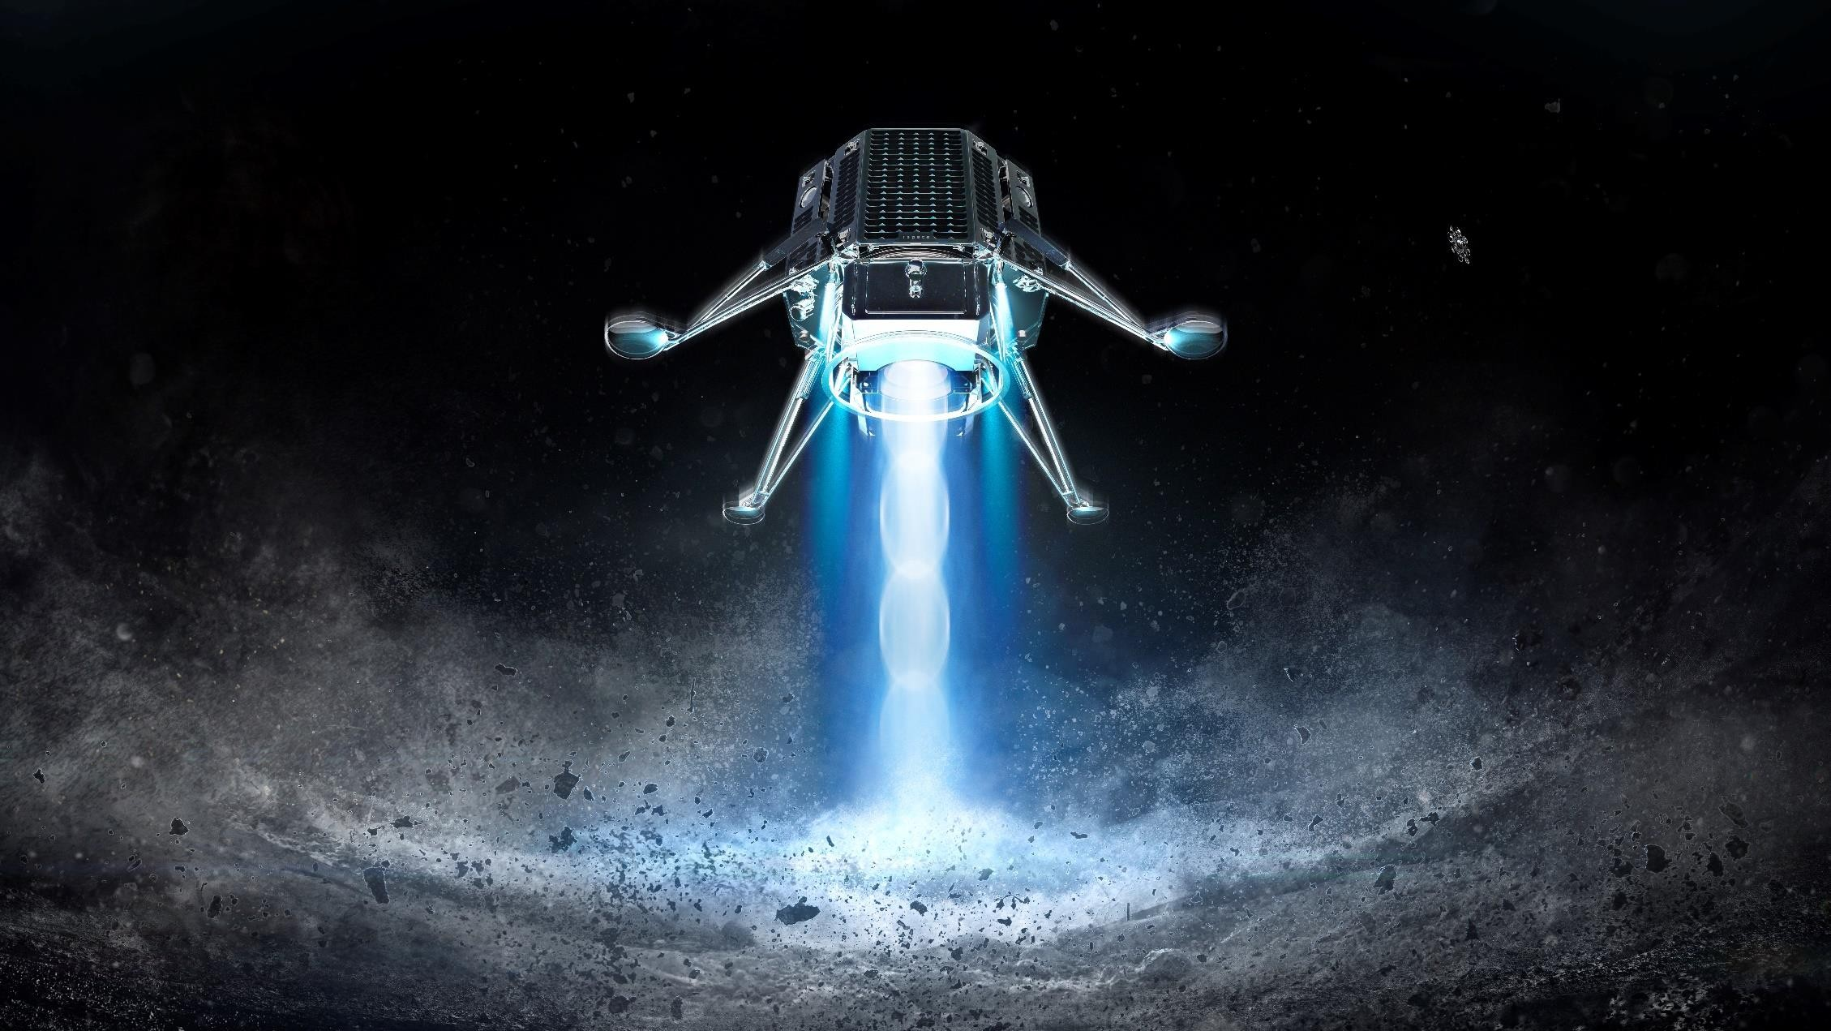

Governing Law
Is outer space the wild wild west?
Extract from SpaceX’s Starlink
contract….
Governing Law:
For Services provided to, on, or in orbit around the planet Earth or the Moon, these Terms and any disputes between us arising out of or related to these Terms, including disputes regarding arbitrability (“Disputes”) will be governed by and construed in accordance with the laws of the State of California in the United States.
For Services provided on Mars, or in transit to Mars via Starship or other colonization spacecraft, the parties recognize Mars as a free planet and that no Earth-based government has authority or sovereignty over Martian activities. Accordingly, Disputes will be settled through self-governing principles, established in good faith, at the time of Martian settlement.
Image courtesy iSpace
5

Slide 6
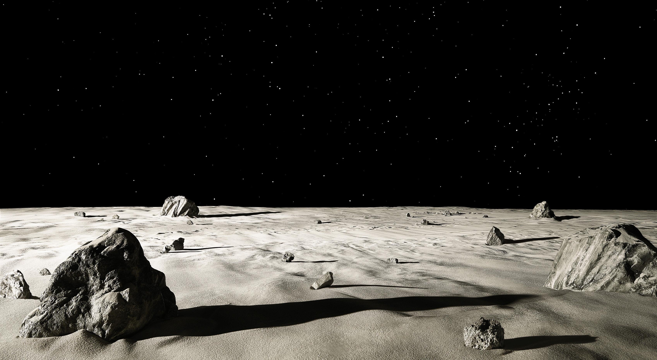
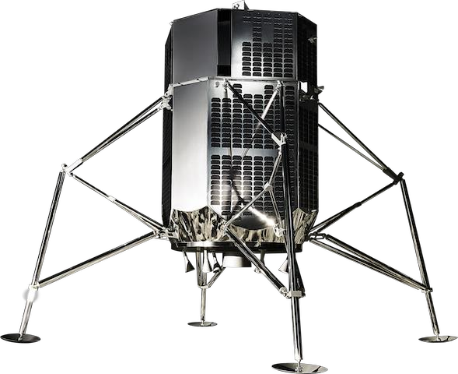


A Unique Commercial Environment
International treaties
National Space Laws
Multi-jurisdictional transactions
Dual use: ITAR and export controls
Access to space is risky
Image courtesy iSpace

Slide 7
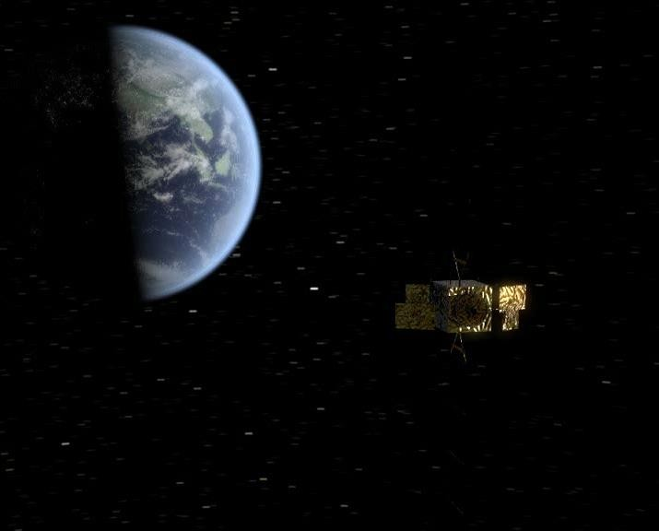
Purchasing and Launching Spacecraft: use only space-specific contracts
The contract must operate in an international space law context, eg:
liability
registration of space objects
debris mitigation guidelines
ITU rules re spectrum use
National space laws, eg:
licensing
insurances
safety
local laws re registration
Dual use complications, eg:
UK Strategic Export Controls/ITAR/EAR)
Missile Technology Control Regime
No fault risk management
– cross waivers of liability

Slide 8
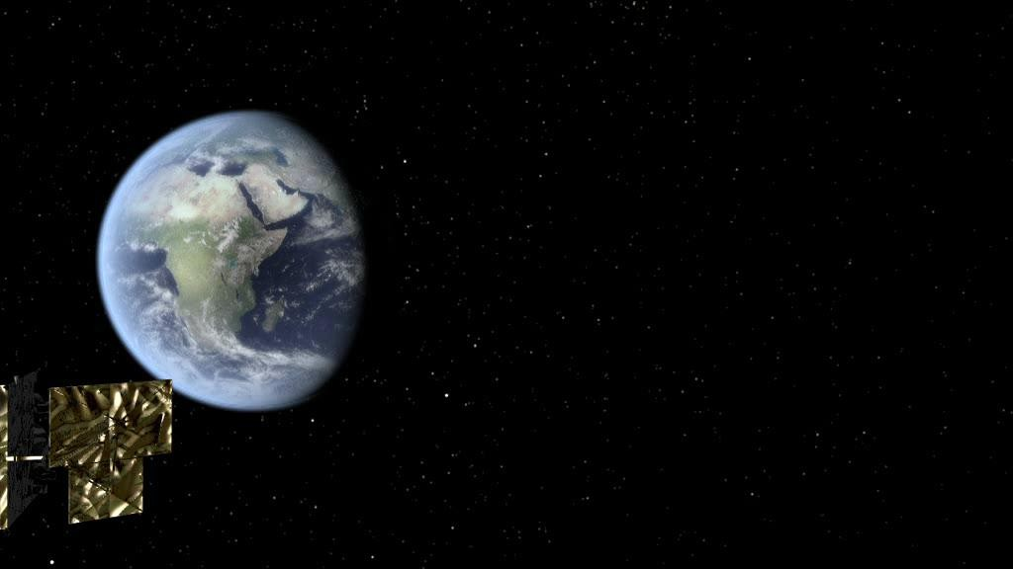
Space contracts manage risks differently
Risks and insurance costs are high
Participants in space missions can cause
loss to other parties and third parties
Cross waivers of liability are designed to protect participants in space missions from one another
Focus is more on time, less on fault
Disputes can arise if risks are not passed from one party to another cleanly
Use of non-space contracts for space activities may lead to unnecessary disputes.

Slide 9
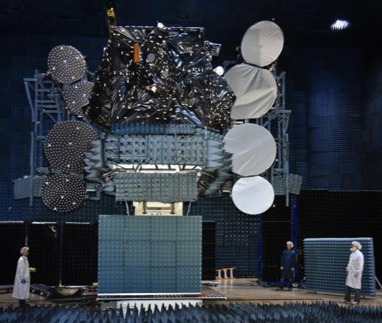
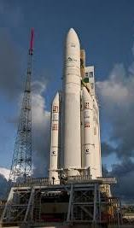
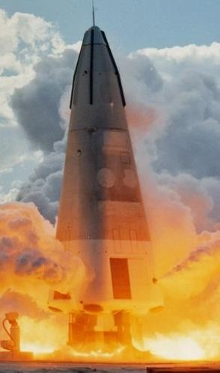
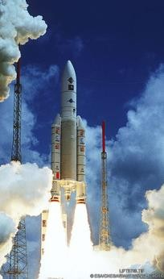
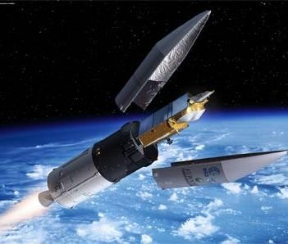
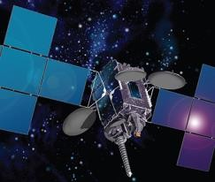

Purchasing Spacecraft – when does risk (commonly) pass?
Vendor’s insurer bears risk
Buyer’s insurer bears risk
Satellite build
Preparation for Launch
Intentional Ignition
Launch
Separation and orbit raising
Operation
Terminated
Ignition
Repair and testing
of spacecraft
Vendor’s insurer bears risk

Slide 10
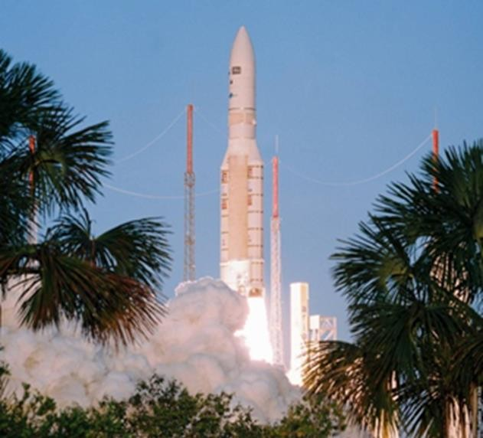
Launching Spacecraft
What do savvy launch customers look for …
Technical and mission compatibility – (mass,
size, orbit)
Launch record
Cost
Schedule and flexibility (dedicated, dual or rideshare?)
Environmental and ethical record
Liability commitments:
are the insurances and cross waivers adequate?
Is the customer protected?
Are launching states protected?
Termination rights for delay

Slide 11
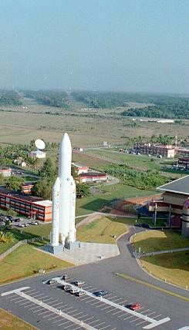
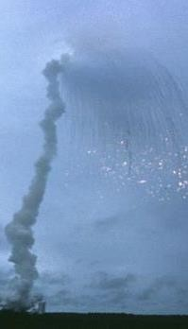
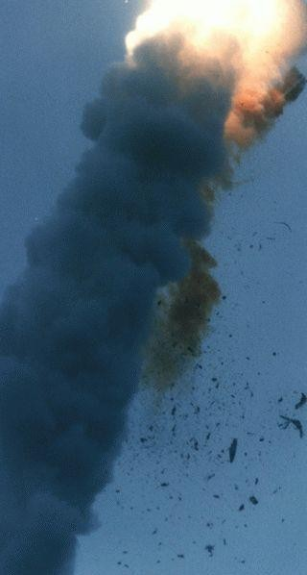
If something goes wrong… who pays?
In most standard launch contracts:
Negligence of all parties is excluded
Inter-party waivers protect the parties
from each other
Launch providers are usually required to purchase insurance to cover losses of uninvolved parties
Over and above the insurance, some governments (eg: US, France and Russia), cover losses of uninvolved parties.
Australia covers the balance of uninvolved party losses … but only losses of Australians

Slide 12
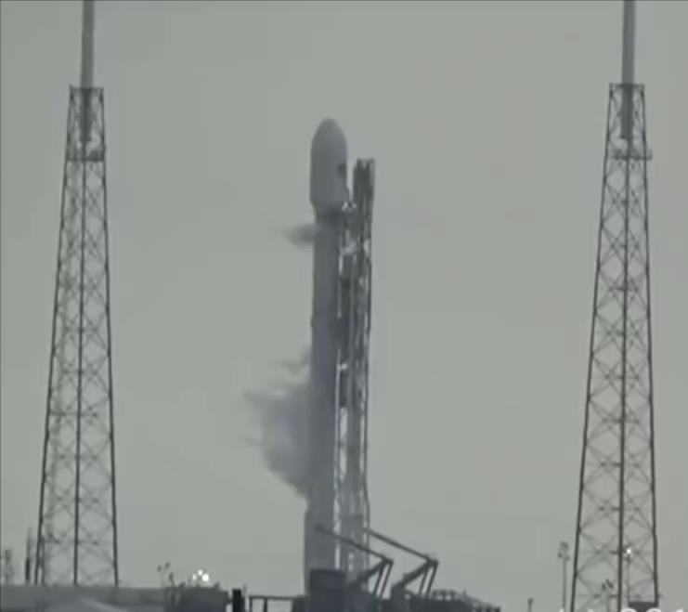

Launching Spacecraft
Example: in this SpaceX accident during fuelling…
…for the lost satellite and rocket?
...for business losses of the satellite owner?
…for losses of third parties (if any)?
If the accident had been caused by one of the payloads, who pays for the other payloads?

Slide 13
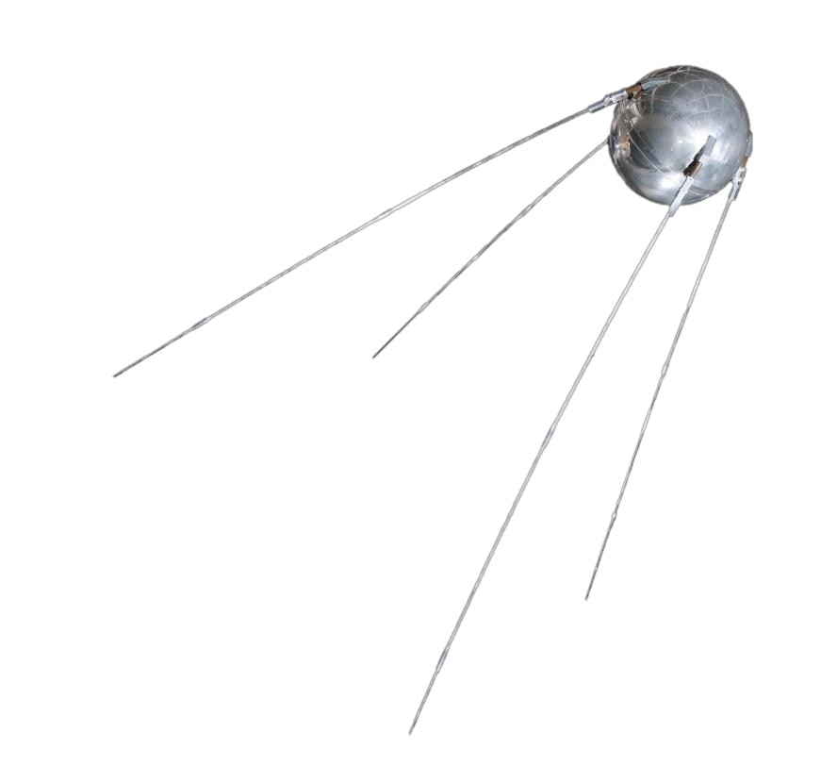
Overarching Guiding Principles:
Future Regulatory Frameworks for Developing Commercial Technology
‘Stewardship’ of the planet
and of outer space
Restoring / retaining the
‘humanity’ of space
Recognition of
‘common interests’
15

Slide 14
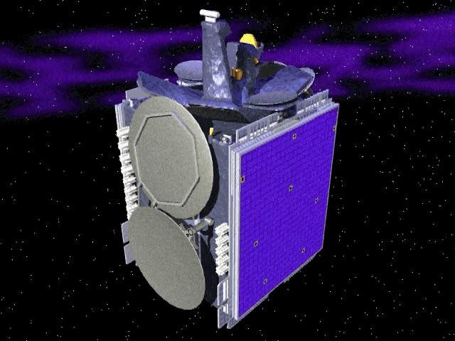
QUESTIONS?

