Slide 1
LONDON INSTITUTE OF SPACE POLICY AND LAW
SPACE POLICY AND LAW COURSE
ON-LINE
9 to 11 November 2020
SPACE ENVIRONMENT AND TECHNOLOGY
Dr Jonathan Eastwood
Director, Imperial Space Lab
London Institute of Space Policy and Law

Slide 2



Handout
4 November, 2020
ISPL 2020 Space Policy and Law Course
Space Environment and Technology
Dr. Jonathan Eastwood Director, Imperial Space Lab
Senior Lecturer, Space and Atmospheric Physics Group, Dept. of Physics Imperial College London, London, UK.
1
Today’s lecture
Part 1
Part 2
Where is space?
Orbital motion
The space environment
Gravity and Newton
Kepler’s laws
Changing orbit
Types of orbit
The Sun
Solar activity
Near Earth space
Where is space? (revisited)
Getting into space
  Objects in orbit
  Constellations and mega- constellations
Space weather
  What is space weather
  Impacts of space weather
2

Slide 3

Handout
4 November, 2020
About me
Senior Lecturer in the Space and Atmospheric Physics group, Dept. of Physics, Imperial College London
  Research into Space Plasma Physics and Space Weather
  Spacecraft data analysis
  Developing and flying instrumentation
  Computer simulations of the near-Earth space environment (the magnetosphere)
Director of Space Lab
  Space Lab is the multidisciplinary network of excellence for all space-related activities at Imperial College London.
  The purpose of Space Lab is to bring together all of Imperial’s activities in space in a coordinated way for the benefit of its members, the College, and society at large.
3
Where is space?
There is no sharp edge between ‘Air’ and ‘Space’
The pressure of the atmosphere falls away exponentially as you go further from the surface
  Small effect in the mountains of Colorado for example (4km)
  Oxygen is a good idea when climbing Mt. Everest (8.85 km)
  Water boils at body temperature (19 km)
  Atmospheric molecules still detectable (1000 km and beyond)
Dr. Melanie Windridge on the summit of Mt. Everest (Credit https://melaniewindridge.co.uk)
4

Slide 4
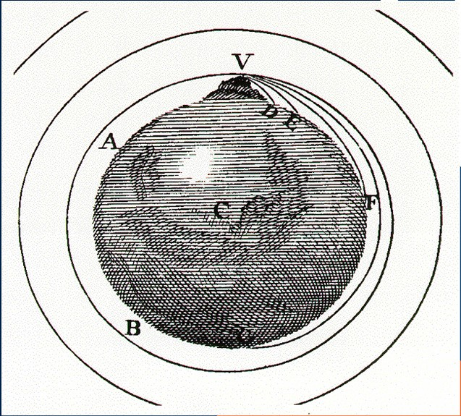
Handout
4 November, 2020
Orbital motion
Newton showed that if you move sideways fast enough as you are pulled towards the Earth, then you can orbit the Earth
! " #$
%
  v = speed of orbiting object
  G = Gravitational constant
  M = mass of the Earth
  r = radius of the orbit
  It doesn’t depend on the satellite
7
Orbital motion
A satellite in a 300 km circular orbit
  r, orbital radius = 6370 km + 300 km = 6670 km
– G = 6.67 × 10⁻¹¹ Nm²/kg²
– M = 5.97 × 10²⁴ kg
– v = 7.73 km/s
The distance of the orbit is the circumference of the orbit, i.e. D = 2πr
The time for one orbit = distance / speed = 5420 s = 90.4 minutes
You cannot break the laws of orbital motion
  If you go faster or slower, you will change your orbit
8

Slide 5
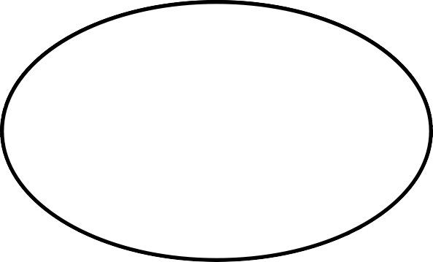
Handout
4 November, 2020
Orbital motion
Newton explained the laws of orbital motion that were established by Kepler in the early 1600s, which Kepler found experimentally using data on planetary motion from Tycho Brahe (his mentor)
Kepler’s laws:
  Orbits are ellipses with the Sun (central body) at one focus
  The radius vector sweeps out equal areas in equal times
  Semi-major axis and period are linked (r³ α t²)
9
Ellipse geometry
Symmetric
Drawing board – two pins, loop of string
Minor axis, length 2b
Major axis, length 2a
Minor Axis length 2b
Eccentricity ‘e’.
Major Axis, length 2a
X X
Focus distance Focus distance
ae from origin ae from origin
ae = distance from origin to focus
e = 0, circle
e < 1 ellipse
(e = 1 parabola, e > 1 hyperbola)
A circle is a special case of an ellipse
10

Slide 6
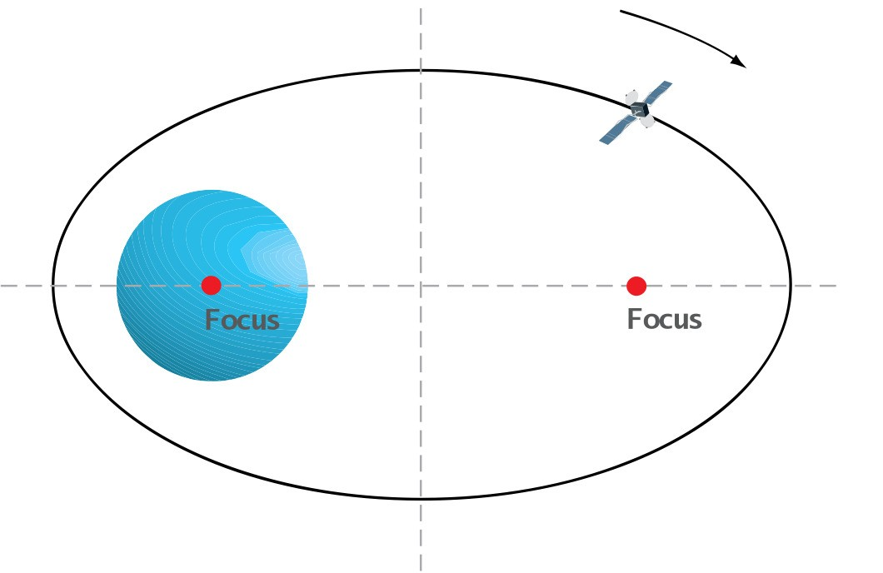
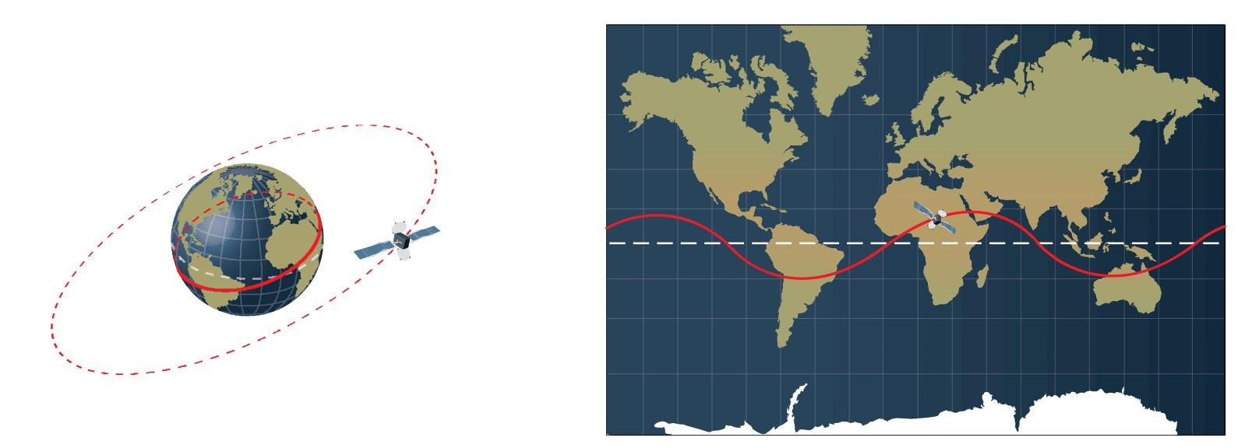
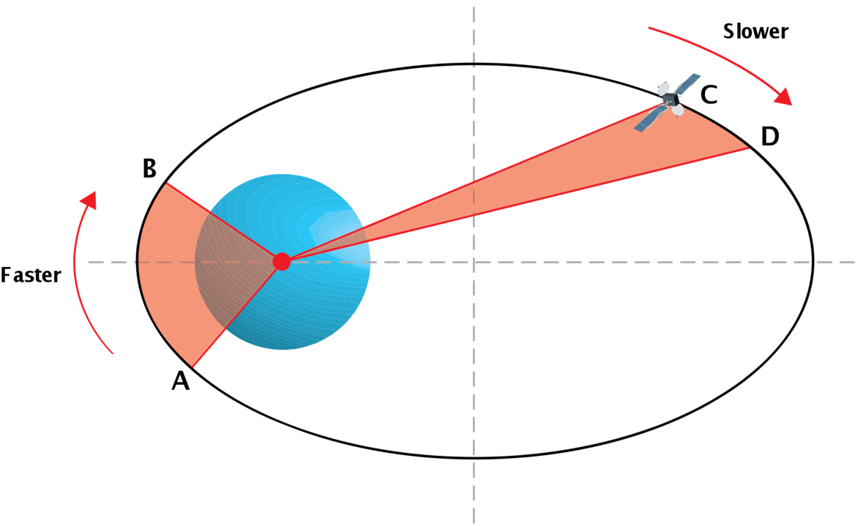
Handout
4 November, 2020
Kepler 1
Newton showed that orbits have to be circular or elliptical
  But also showed open orbits must be parabolas or hyperbolas
Also applies to planets orbiting the Sun
  e.g. Earth’s orbital eccentricity is 0.017 (more or less circular!!)
11
Kepler 2
The satellite sweeps out equal areas in equal times.
For a circular orbit this is self- evident
This means the satellite goes faster when it is closer to the planet
12

Slide 7
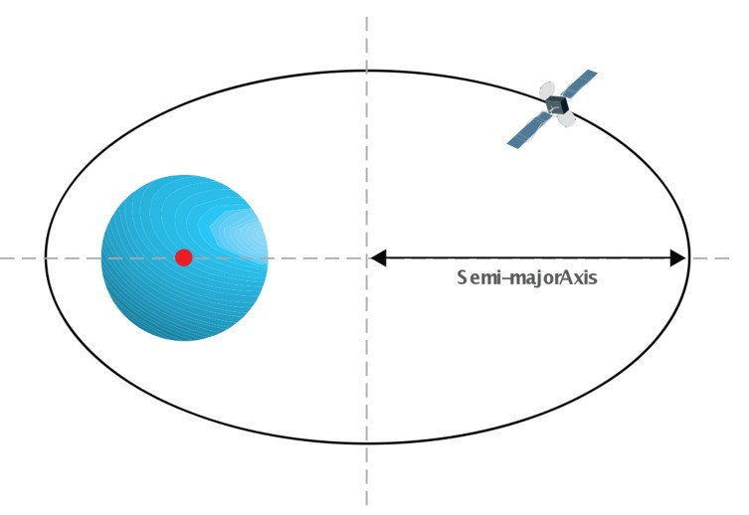
Handout
4 November, 2020
Kepler 3
The period of the orbit depends on the size of the orbit, defined by the semi-major axis in a specific way
&
'
4)*⁺
" #$
This is what we already found for a circular orbit
It doesn’t depend on the shape
  an elliptical orbit with semi major axis a and a circular orbit radius a have the same period
  But on an elliptical orbit the speed changes, whereas on a circular orbit it is constant
13
Changing orbits
Hohmann Transfer Orbit
  Start in the orange orbit
  Accelerate at point A to match the correct speed for the purple transfer orbit
  Spacecraft coasts from point A to point B
  Accelerate again at point B to match the correct speed for the final green orbit.
E.g. to transfer from Earth to Mars
  Earth and Mars have to be lined up – hence missions to Mars go approx. every two years
A
B
14

Slide 8
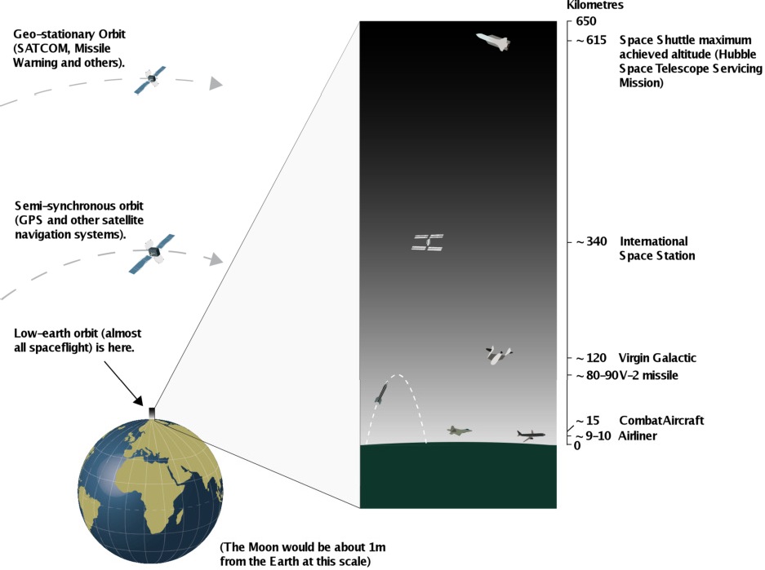
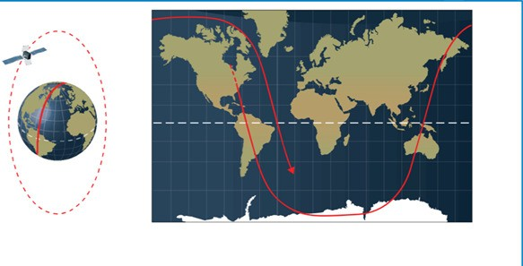

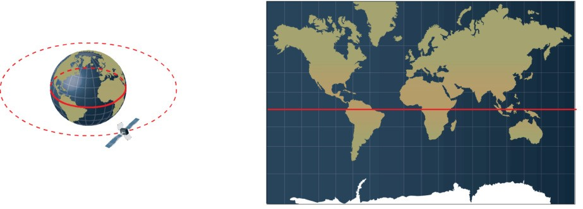
Handout
4 November, 2020
Types of orbit
Low Earth Orbit (LEO).
  200-1200 km altitude? t=90-120 mins
Medium Earth Orbit (MEO).
  20 200 km altitude. t= 12 hours
Geostationary Orbit (GEO).
  35 800 km. t=24 hours
Highly Elliptical Orbits (HEO).
  various
15
Types of Orbit
Polar orbit
Circular inclined orbit
Equatorial orbit
16

Slide 9
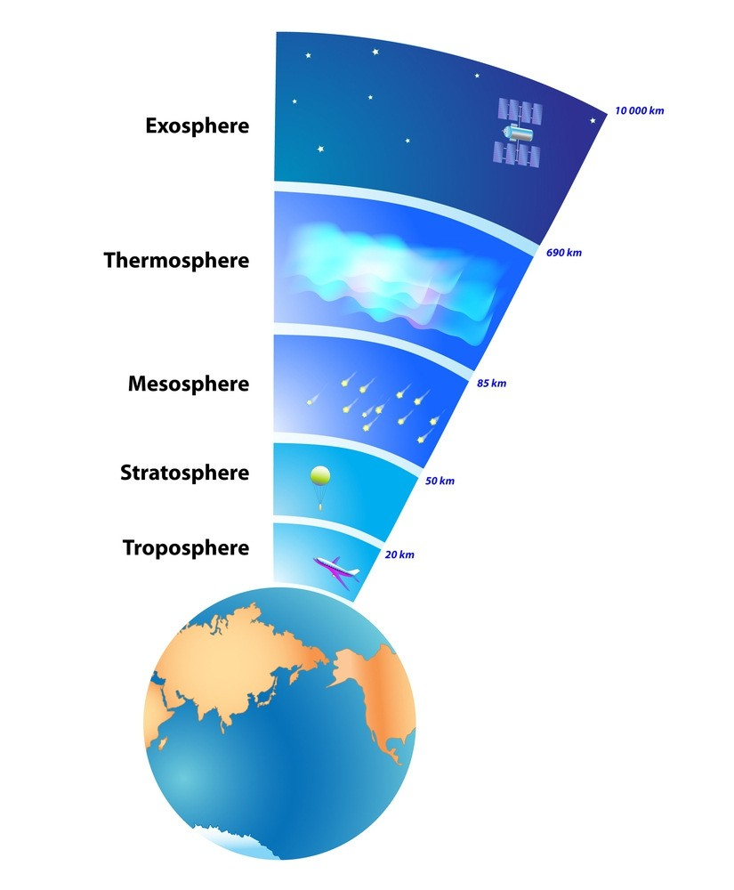
Handout
4 November, 2020
Where is space? (revisited)
Instead of asking where space starts, can ask where space stops
How low do you have to go for atmospheric drag to dominate forces?
Turns out to be between 70 and 90 km
McDowell [Acta Astron., 151, 668, 2018] argues that 80 km is a practical reasonable boundary.
  Archival orbit data suggests once the perigee drops below 80 km, a satellite does not survive more than one orbit [McDowell, Physics Today, Oct. p71, 2020]
  At 100 km, satellites can survive in orbit [ibid, p71]
17
Structure of the atmosphere
Troposphere – where we live
Stratosphere – up to 50 km
Mesosphere – up to 80 km
  Hard to access except by sounding rockets, sub-orbital launch
  An intermediate region?
McDowell suggests this could be a physical basis for a division between air and space
https://futurism.com/wp-content/uploads/2013/04/Layers-of-Earths-Atmosphere.jpg
18

Slide 10
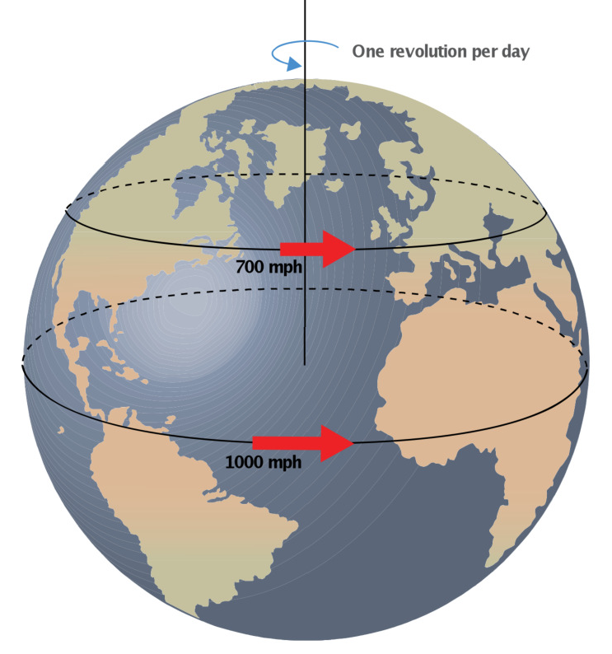
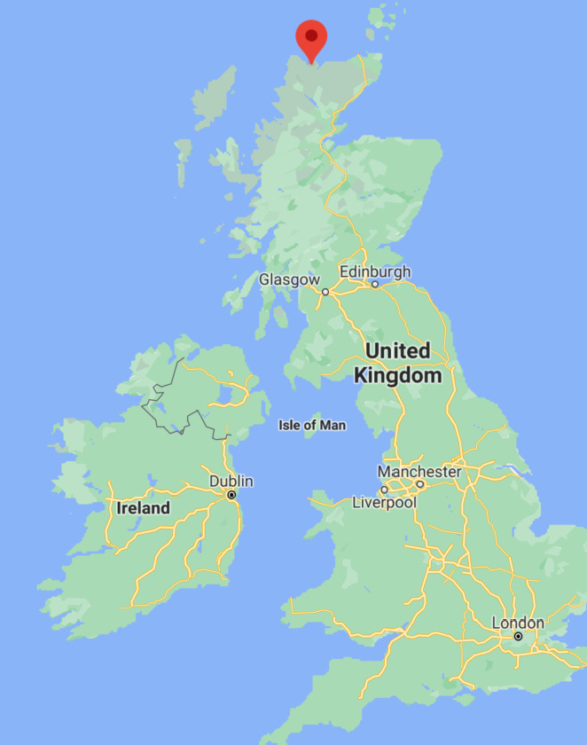
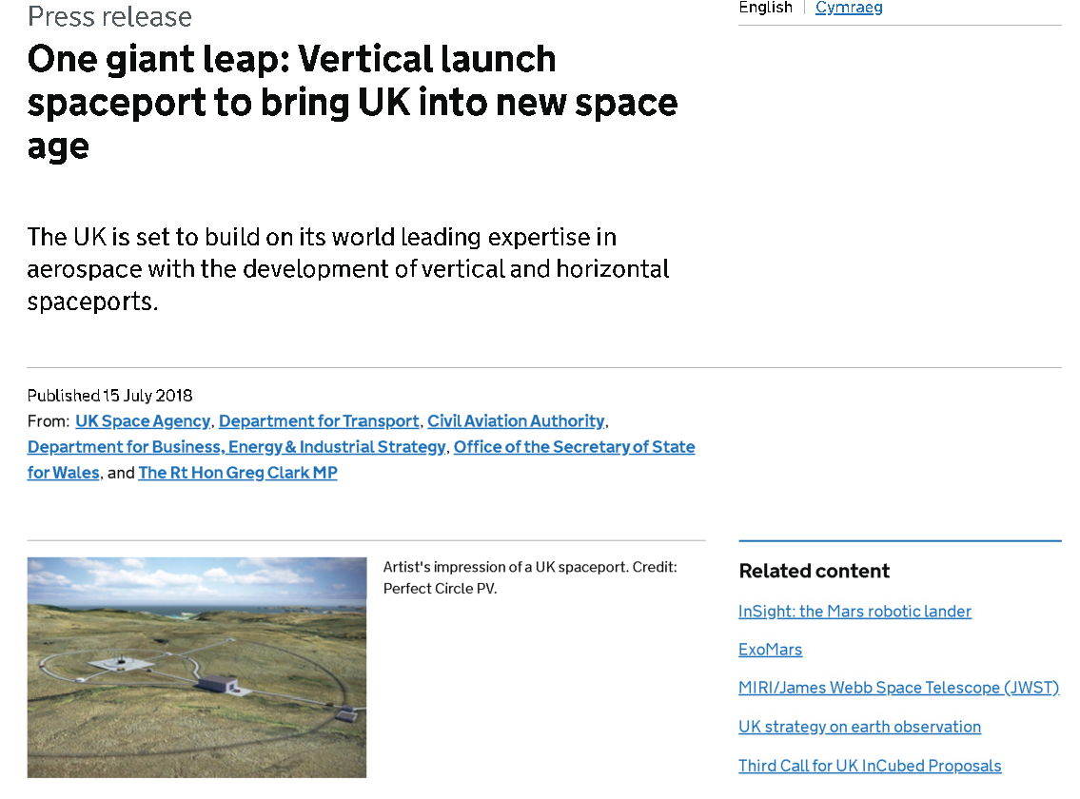
Handout
4 November, 2020
Getting into space
In terms of energy, the problem is not just to move vertically against gravity, but to move fast enough sideways to be in orbit
The surface of the Earth moves faster at the equator
  Can use this to gain a higher initial velocity
  Equatorial launch sites are advantageous for getting into e.g. geostationary
19
UK Space Port
20

Slide 11
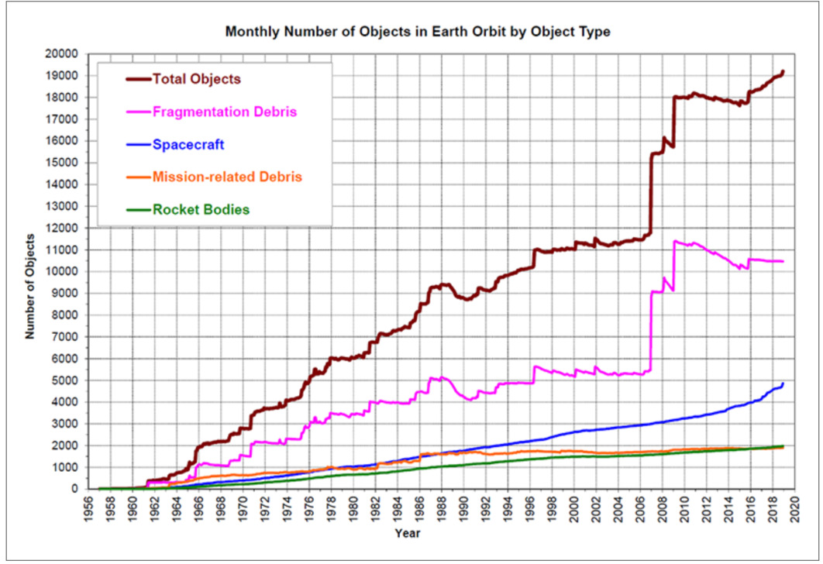
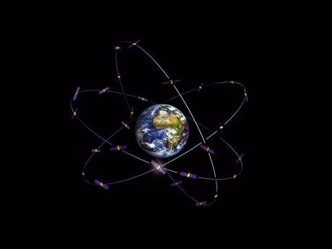
Handout
4 November, 2020
Objects in orbit
Space Traffic Management is an issue of crucial importance
Iridium 33/Cosmos 2251
The number of objects in space is only going to increase
Fengyun-1C
How should space missions and projects plan end-of-life disposal
  Re-entry
  Graveyard orbits
– …?
Objects > 10 cm in orbit https://orbitaldebris.jsc.nasa.gov/modeling/legend.html
21
Constellations
Galileo: 3 MEO planes @23,000km, each with 10 sats.
Spacecraft constellations are of growing interest
Global Navigation Satellite Systems (GNSS)
  GPS
  GLONASS
  BeiDou
  Galileo
A crucial element of modern society
Credit: ESA-J. Huart
22

Slide 12
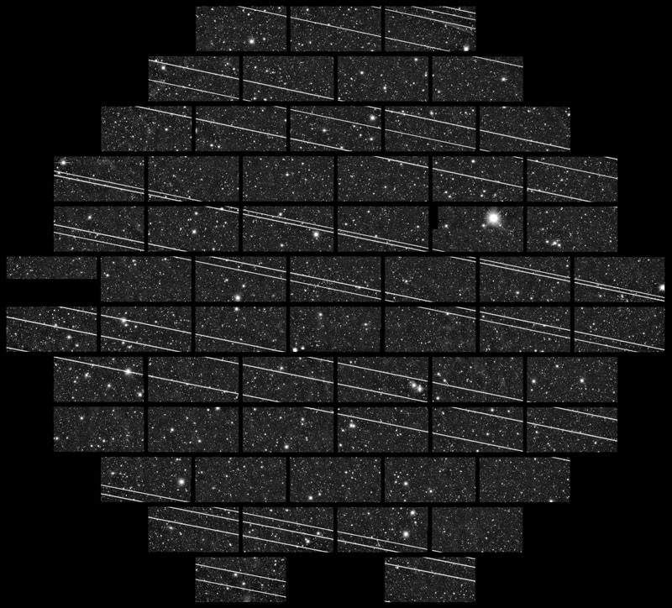
Handout
4 November, 2020
Mega-constellations
We can now build lots of small cheap satellites (so-called ‘new-space’)
https://www.nature.com/articles/d41586-020-02480-5
SpaceX Starlink (12,000)
– One Web (48,000)
Amazon Kuiper (3,236)
etc
Many, many issues relating to the safe deployment, use and disposal of mega-constellations to deliver internet access anywhere on Earth
23
Today’s lecture
Part 1
Part 2
Where is space?
Orbital motion
The space environment
Gravity and Newton
Kepler’s laws
Changing orbit
Types of orbit
The Sun
Solar activity
Near Earth space
Where is space? (revisited)
Getting into space
  Objects in orbit
  Constellations and mega- constellations
Space weather
  What is space weather
  Impacts of space weather
24

Slide 13
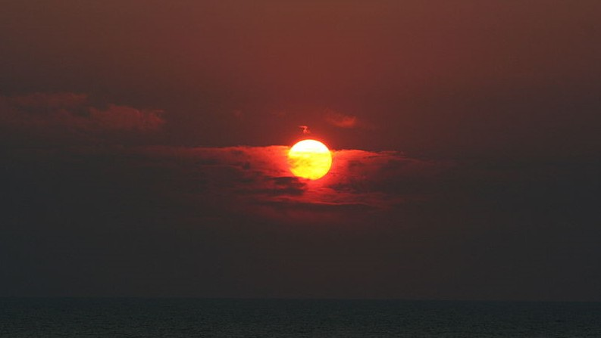
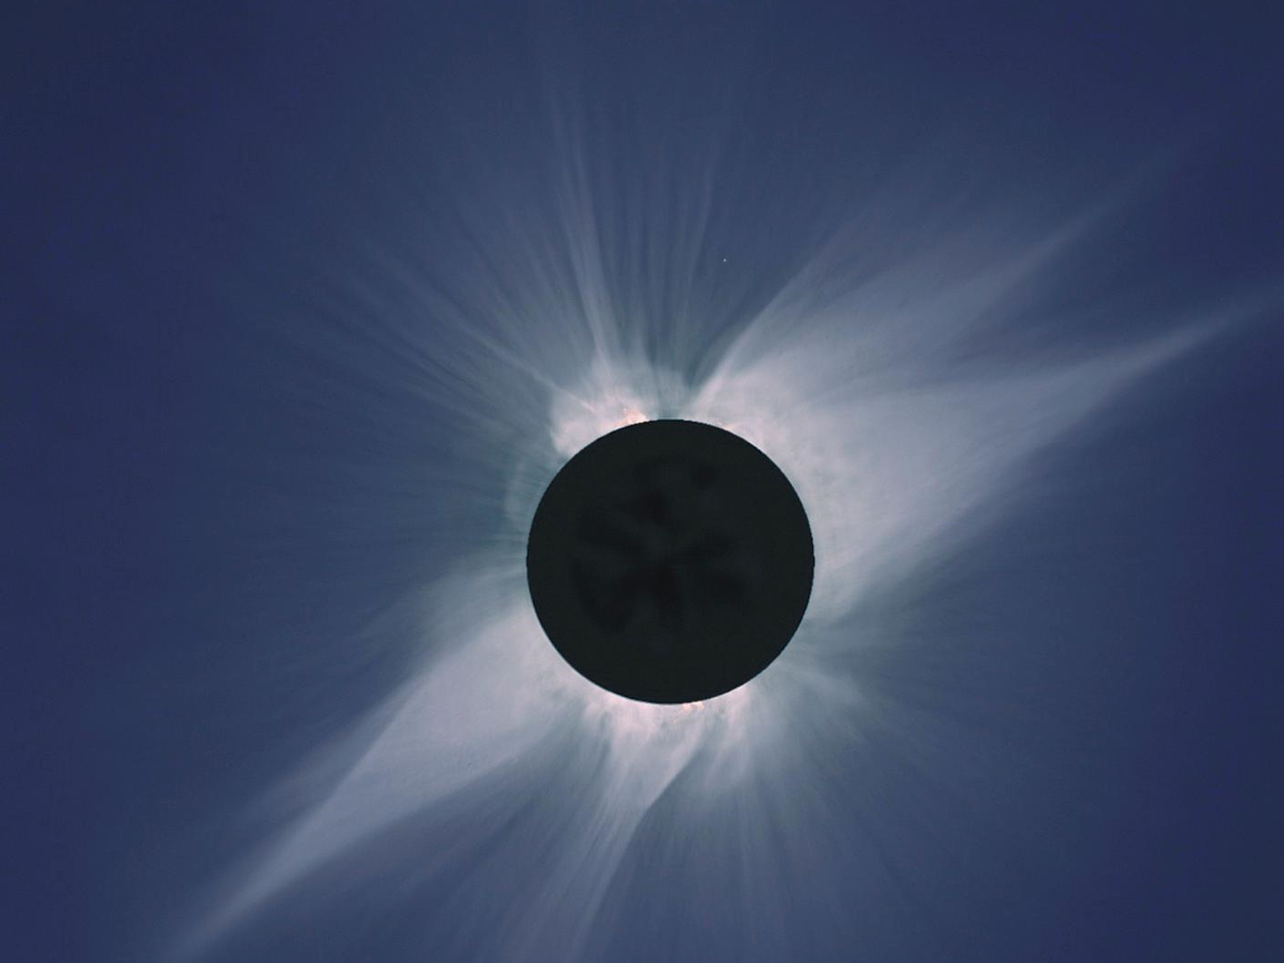

Handout
4 November, 2020
Credit: wikimedia.org
The Sun!
25
Baja California Eclipse 1991
Credit: Steve Albers, Dennis di Cicco, Gary Emerson
26

Slide 14
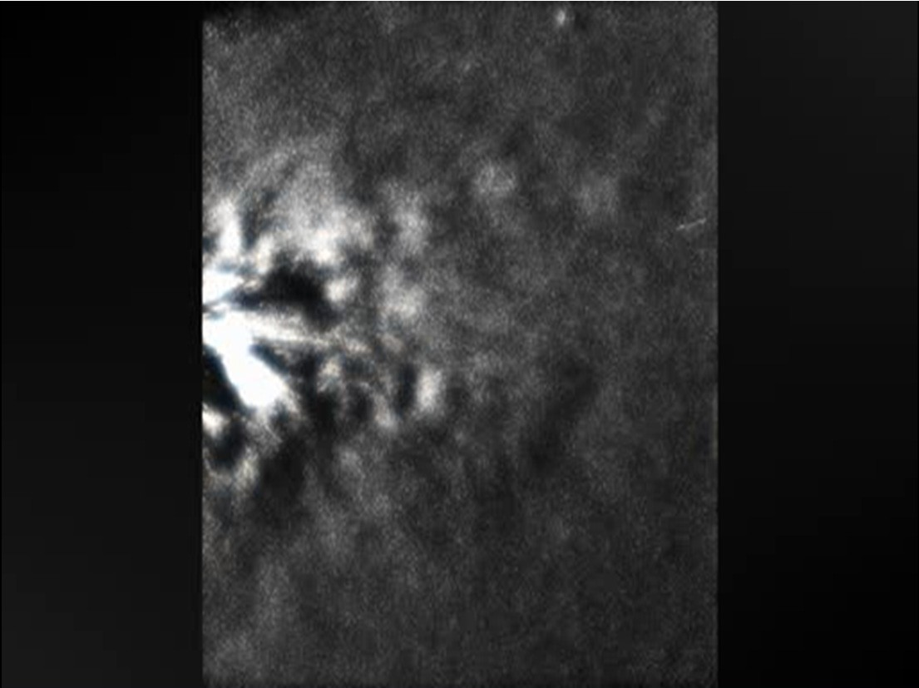
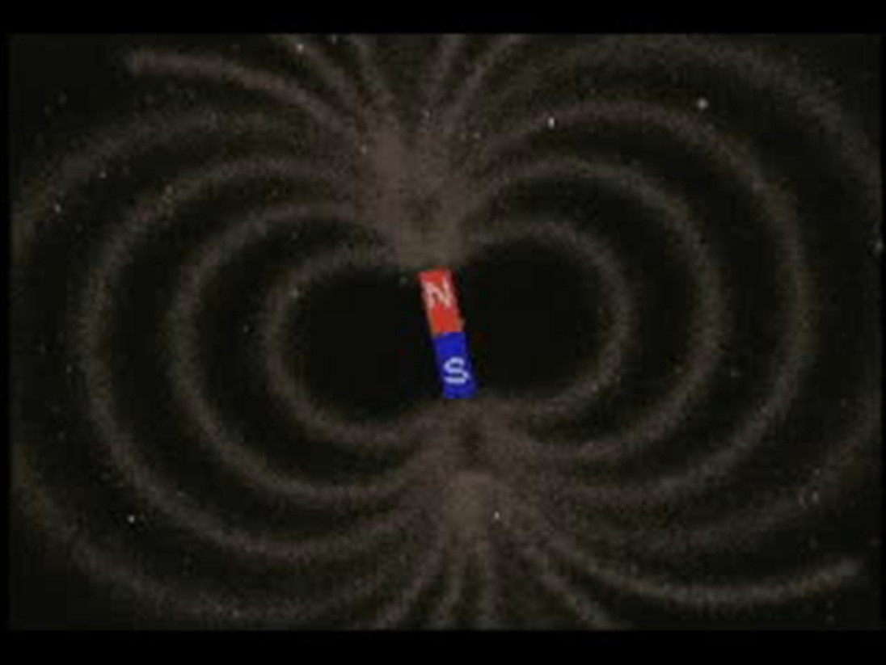
Handout
4 November, 2020
Outer space is not empty!
The real solar wind
It contains plasma (charged particles) and electric and magnetic fields
These plasma are very rarified
But they are very important!!
Image credit:
NASA/ STEREO/ Heliospheric Imager
27
Earth’s magnetic field extends up into space where it meets the solar wind
The interaction of the solar wind and the Earths’ magnetic field forms a structure called the magnetosphere
Image credit: NASA
The Earth’s magnetosphere
28

Slide 15
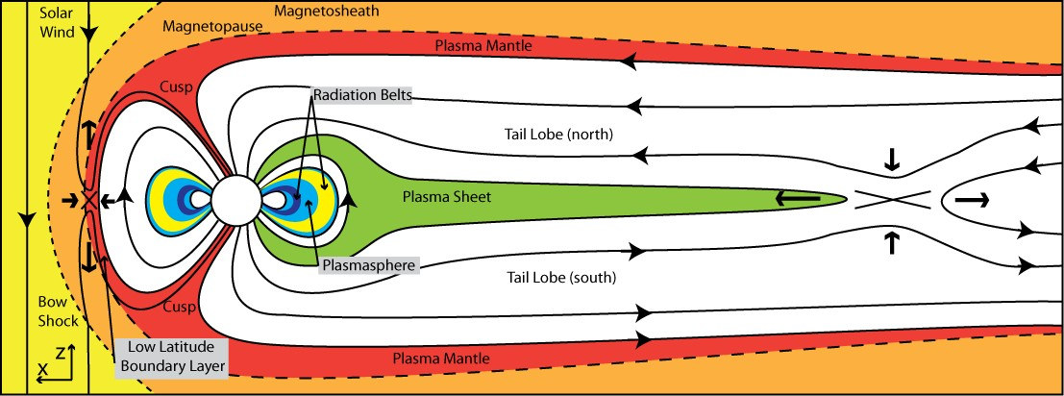
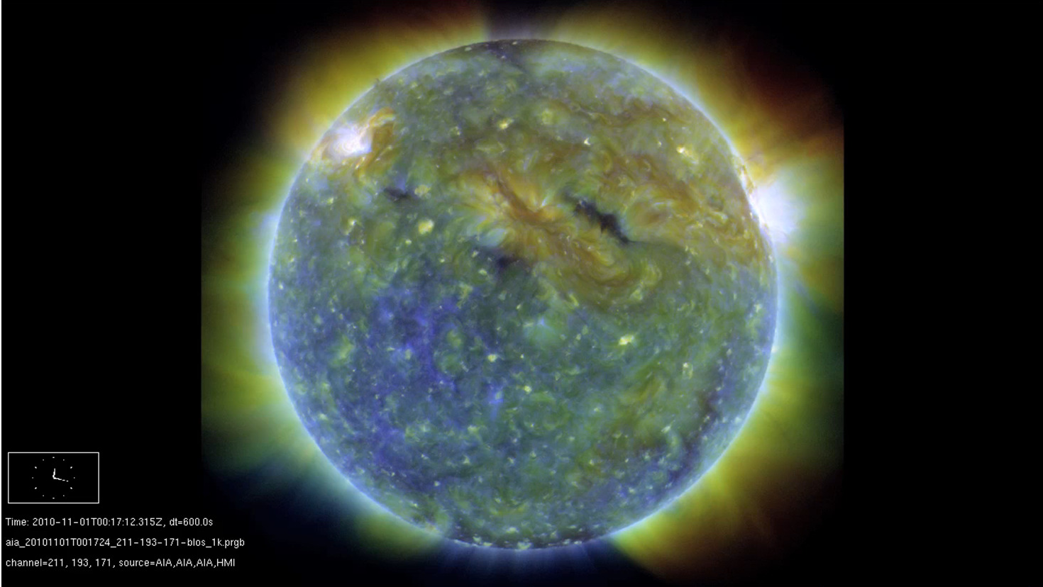
Handout
4 November, 2020
Earth’s magnetosphere
Shown roughly to scale - highly structured
Trapped regions of particles – radiation belts sit inside GEO
[Eastwood et al, Space Sci Rev. 2015]
29
Credit: NASA/Solar Dynamics Observatory
30

Slide 16

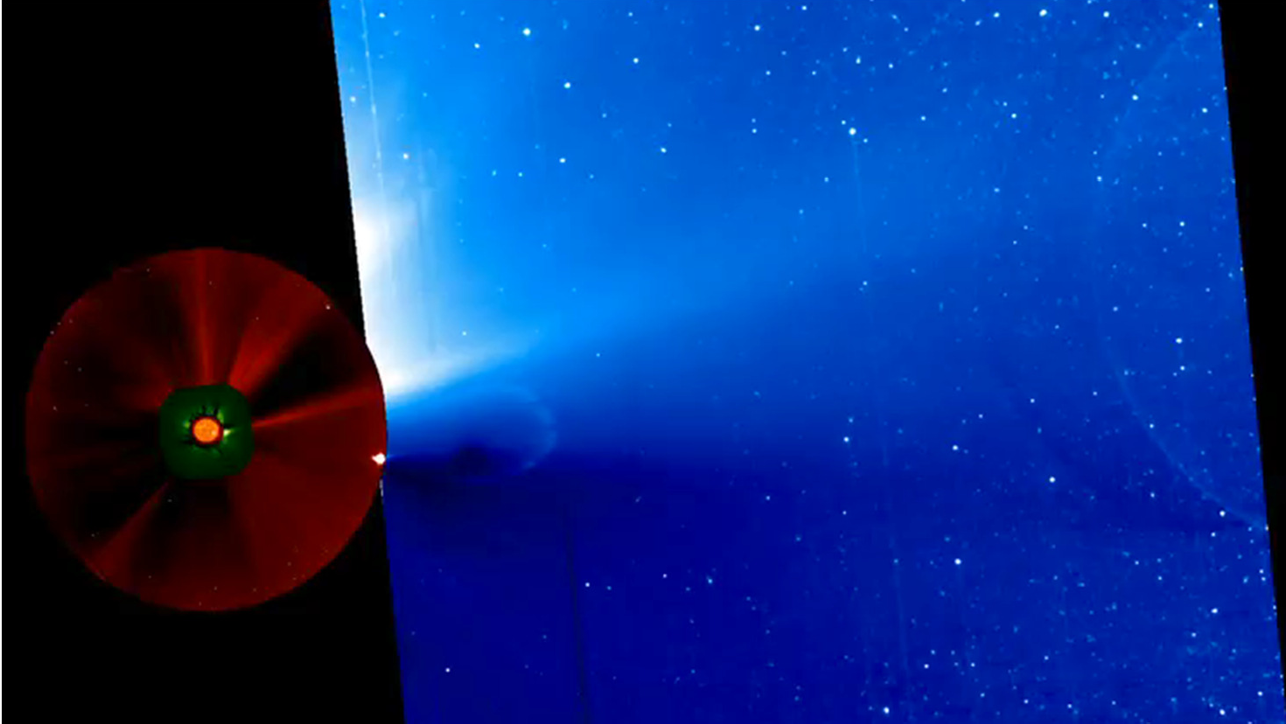
Handout
4 November, 2020
Credit: NASA/Solar Dynamics Observatory
31
Coronal Mass Ejection
Credit: NASA/ STEREO/ Heliospheric Imager
32

Slide 17
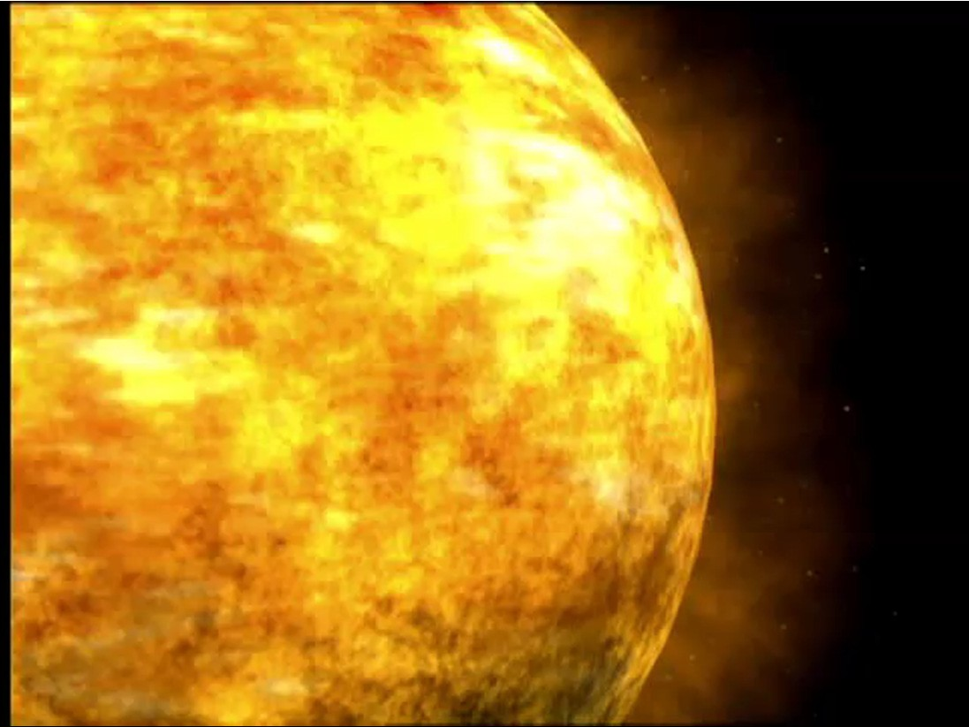
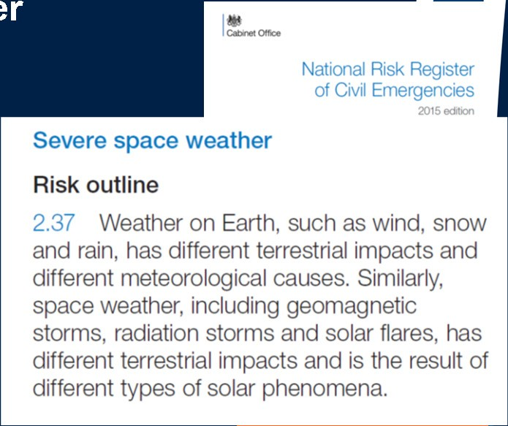
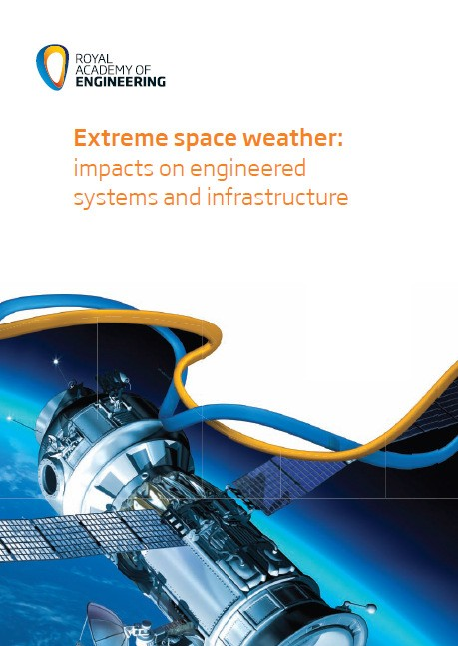
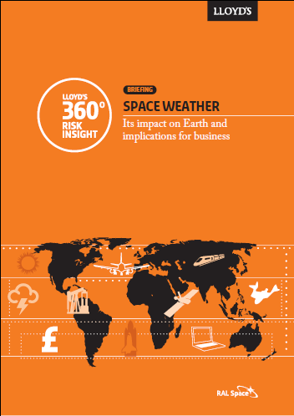
Handout
4 November, 2020
Movie credit: NASA
Space Weather
33
Space weath
er
34

Slide 18
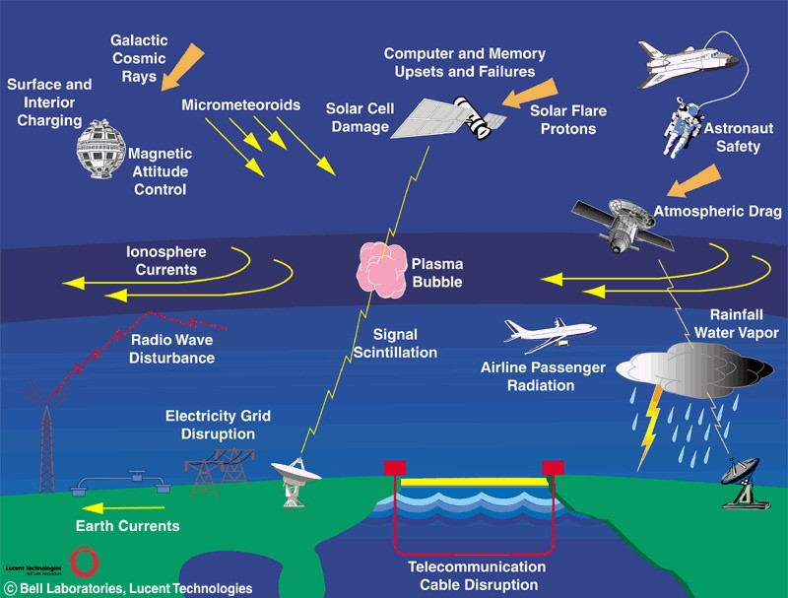
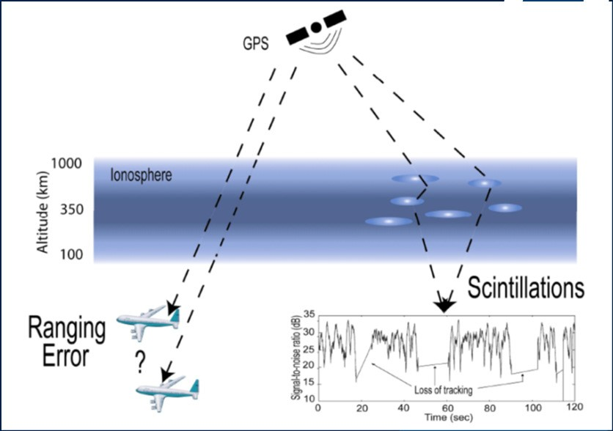
Handout
4 November, 2020
Space Weather
35
Global Navigation Satellite Systems
Aviation
Surveying companies
Deep-sea drilling
Land drilling and mining
Military operations
36

Slide 19
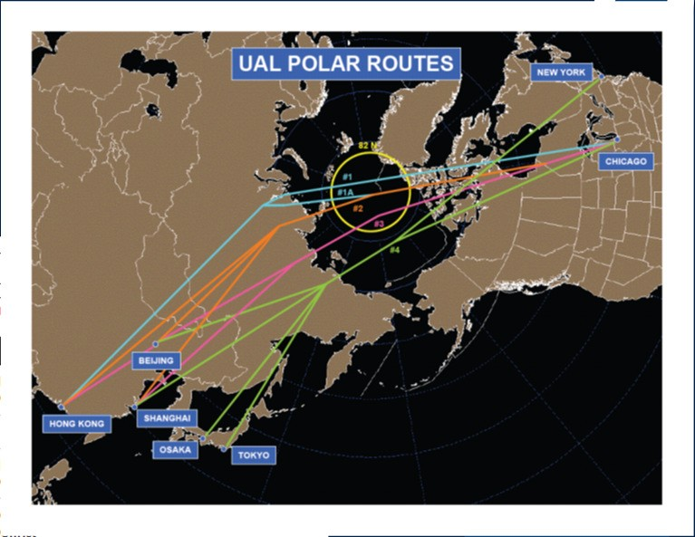
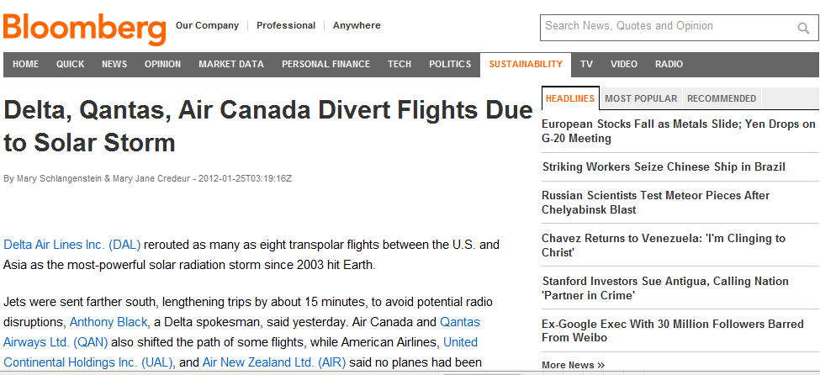
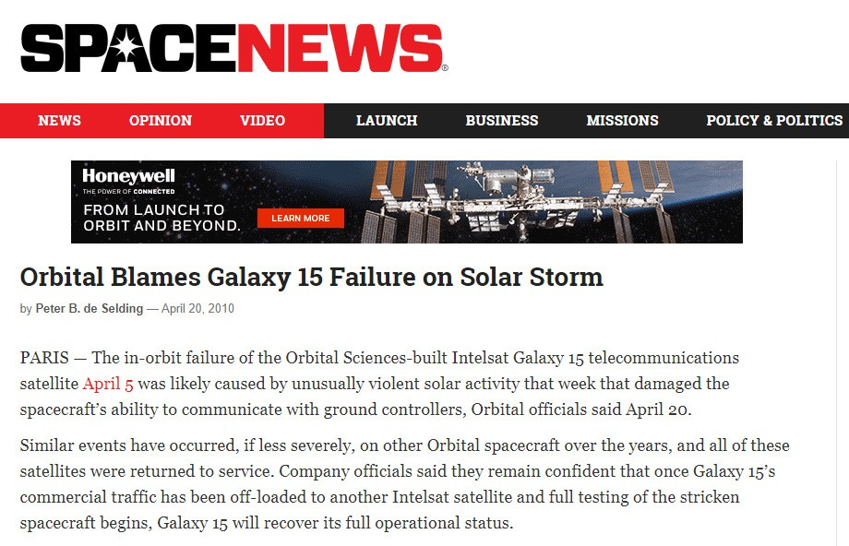
Handout
4 November, 2020
Air travel
37
Satellite anomalies
During the October - November 2003 space weather events, 33 Earth orbiting satellite anomalies were reported.
Impacts
  surface and deep dielectric charging
  surface damage and solar panel degradation
  background counts in sensors
  satellite drag and changes to orbits.
Renewed interest because of solar electric propulsion and orbit raising
38

Slide 20
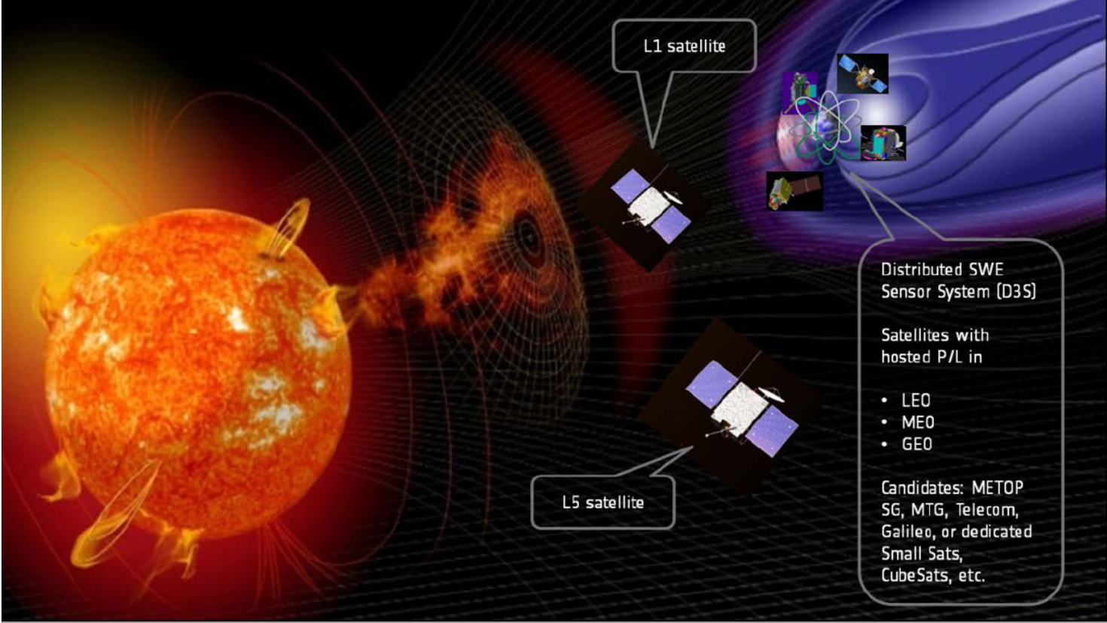
Handout
4 November, 2020
Space weather monitoring – the goal
Image credit: ESA
39
Today’s lecture
Part 1
Part 2
Where is space?
Orbital motion
The space environment
Gravity and Newton
Kepler’s laws
Changing orbit
Types of orbit
The Sun
Solar activity
Near Earth space
Where is space? (revisited)
Getting into space
  Objects in orbit
  Constellations and mega- constellations
Space weather
  What is space weather
  Impacts of space weather
40

