Slide 1
Risk, Liability & Insurance Considerations
Space Law Certificate Course 2019
Neil Stevens
LLB (Hons) LLM (Lond)
October 2019, London
London Institute of Space Policy and Law

Slide 2
International Conventions
The 1967 Treaty on Principles Governing the Activities of States in the Exploration and Use of Outer Space, including the Moon and Other Celestial Bodies (the "Outer Space Treaty").
The 1968 Agreement on the Rescue of Astronauts, the Return of Astronauts and the Return of Objects Launched into Outer Space (the "Rescue Agreement").
The 1972 Convention on International Liability for Damage Caused by Space Objects (the "Liability Convention").
The 1975 Convention on Registration of Objects Launched into Outer Space (the "Registration Convention").
The 1979 Agreement Governing the Activities of States on the Moon and Other Celestial Bodies (the "Moon Treaty").

Slide 3
Liability Convention 1972
Article II
" A launching State shall be absolutely liable to pay compensation for damage caused by its space objects on the surface of the earth or to aircraft in flight. “
There is thus a strict liability standard applicable to the State(s) for such damage caused by a space object, launched within its responsibility, even when damage is caused by circumstances outside of its control.
Article III
" ...damage elsewhere...to a space object.. launching State shall be liable only if the damage is due to its fault... “
For damage sustained in space a fault liability standard applies such that the State is liable only to the extent that such damage is caused by fault of the State (or States) responsible for the launch

Slide 4
Liability Convention 1972
Article V
" Whenever two or more States jointly launch a space object , they shall be jointly and severally liable for any damage caused.
Note: Article IV extends this principle in case of damage caused in space to a space object of a third State and, without prejudice to the rights of the third State, the burden of compensation shall be apportioned between the first two States i.a.w. the extent to which they are at fault or, if this cannot be established, equally.
Article VIII
" A State which suffers damage, or whose natural or juridical persons suffer damage, may present to a launching State a claim for compensation for such damage.. “
Any action under the Convention to seek compensation for damage must be pursued as between the States concerned.
Article X
" A claim...may be presented .. not later than one year following the date of the occurrence of the damage or the identification of the launching State which is liable. “
There is a statute of limitation of one year.

Slide 5
Liability Convention 1972
Articles X-XV
address the procedures to be followed to file a claim under the Convention.
Note that whilst a State may pursue a claim under the Liability Convention it may alternatively seek redress by application to the courts of the launching State but it cannot do both.
Whom may claim ?
This is a Convention to facilitate the payment of compensation.
State to present claims sustained by itself and by its nationals /person in its territory / permanent residents.
Claims to be presented through 'diplomatic channels'

Slide 6
Liability Convention 1972
DEFINITIONS
‘Launching State' means:
(i) A State which launches or procures the launching of a space object ;
(ii) A State from whose territory or facility a space object is launched ;
(Thereby there are four categories of State, each treated on the same footing.)
Space Object means:
(i) Component parts of a space object; and
(ii) Its launch vehicle and parts thereof.
(Thereby the phrase, found in OST 67, of "launching ..into outer space" is avoided.)
Damage means:
(i) Loss of life, personal injury or other impairment of health;
(ii) Loss of or damage to property of States, of persons or of IGOs.
Unlike other liability based conventions The Convention does not
contain any limitation of liability
set out the law applicable to the heads and amount of compensation

Slide 7
Liability Convention 1972
ADDITIONAL INFORMATION
The third of the five International Treaties with the third highest number of ratifications (89) and signatories (22), include most, if not all, of the space-faring nations.
The OST and the Liability convention are the most important treaties.
Introduces a comprehensive Third Party Liability (TPL) regime in respect of damage caused in air, space and on the ground.
Some potential problems with definitions e.g.
in certain circumstances which State is deemed to be the “launching state”?
what constitutes a “space object”?
to what extent can space debris be considered a space object?
what is meant by “fault” and “negligence” (both terms being used)?
is indirect damage covered as well as direct damage?
does not cover “domestic” damage.
There are likely to be some different interpretations under different national legal systems

Slide 8
Liability Convention 1972
ADDITIONAL INFORMATION
Where damage has been caused to persons or property that is insured, insurers would normally look to exercise subrogation rights against the persons responsible for the cause of the damage. The insurer could only invoke the provisions of the Convention through the intervention of the relevant State (not necessarily the State of the insurers).
If space debris is considered to be a space object, in circumstances where debris causes damage, it may not be possible to trace it to a particular launching State
Only one instance where the Liability Convention was invoked (under article 2 - strict liability in respect of damage on earth): In 1978 Soviet Spacecraft RORSAT Cosmos 954, in part survived re-entry and left a scattering of radio-active debris on Canadian territory. Canadian Gov. lodged a $6M claim to clean up. Was settled for $3M on diplomatic basis (without recourse to a Commission established for the specific purpose as envisaged in the Convention)

Slide 9
Liability Convention 1972
ADDITIONAL INFORMATION
Has never been a claim made under Article 3 of Liability Convention relating to damage in orbit (where proof of fault is required).
However, this would have been possible in 2009, when the Iridium-33 civil communication satellite was in collision with COSMOS 2251 (a derelict Russian military satellite). Some speculation as to why Iridium LLC, the operator, did not seek to invoke the Convention through the intervention of US Gov.(difficulty to prove Russian fault, Iridium satellite at end of life and relatively low value.
(If Iridium-33 was insured under an “all risks first party” insurance, the insurer(s) (not necessarily a US entity) would ordinarily have been entitled to invoke a subrogation clause in the event of payment of an insurance claim but would need to invoke the Convention provisions through the intervention of the US Government.)
A further possible complication is the determination of the “launching State”. Iridium is a US Corporation which procured the satellite and its launch but the launch itself was undertaken by the Russian Space Agency on a Proton vehicle from Baikonour in Kazakhstan. Therefore Russia or Kazakhstan could be considered to be the launching state.

Slide 10
Liability Convention 1972
ADDITIONAL INFORMATION
The OST and the Liability Convention are the main pillars of international law governing space activities and most space-faring nations have ratified them;
No revision agreed of UN space treaties since they came into force (OST is 50 years old and this year is the 45th anniversary of the Liability Convention). This is in contrast to e.g. aviation treaties which have been subject of a number of major revisions. There have however been further Resolutions of the UN General Assembly relating to use of outer space. Also a work programme of review of States practices/national legislation;
Difficulty in enforcement of Treaties in specific cases. Depends on cooperation of parties and on diplomatic pressure;
Treaties were concluded in the infancy of space activity when only governments were funding and initiating activities. Many developments were not anticipated such as the volume of activities, range of space applications, number of space players, problem of space debris, growth in commercial activities, and suborbital space tourism etc.

Slide 11
Do the Treaties Work?
An increase in space activities and of commercial space activities in particular, is likely to increase the number of incidents where Treaties may be invoked and put to the test.
Some further uncertainties with the Liability Convention:
The Liability Convention does not expressly provide the sole and exclusive cause of action;
The State concerned may be reluctant to invoke the Liability Convention for a specific incident;
What otherwise would be the legal regime and jurisdiction applicable to third party claims ? (There may be options as to which legal regime to invoke);
What would be the effect on the licensing arrangements?
Can a form of claims management/dispute resolution be devised in which commercial parties can have confidence ?
Are the provisions appropriate for occurrences in space involving private parties; will private parties want claims managed by States or will they prefer self control ?

Slide 12
Benefits of the Treaties
There is a link between the OST 1967 and the subsequent treaties so that even where the subsequent treaties have not been ratified, ratification by a State of the OST indicates a commitment to issues addressed there and further elaborated in the subsequent treaties;
With some exceptions e.g. the Moon Agreement, there has been almost universal acceptance of the Treaties by the space-faring nations;
The Treaties provide public interest protection for damage on the surface of the Earth or to aircraft in flight;
They do provide for State liability in case of operator default or non existence at time of occurrence;
They do provide long tail liability, without a time limitation defence (save following an occurrence);
They have provided a reference point for registration and licensing of space activities at State level;
The Liability Convention provides that its invocation would not stand in the way of any claim for the same event being pursued “in the courts or administrative tribunals or agencies of a Launching State”

Slide 13
Current Risk Environment
The legacy of near 5000 launches made by all space faring nations.
The reliability of launch vehicles and of satellite performance;
The capital values in space assets are large but nothing compared to the values of terrestrial assets;
The widespread distribution of satellites around the GEO ring;
The existence of data sharing amongst major commercial operators of GEO satellites;
The rarity of collisions involving space objects and none with an aircraft in flight;
The ability of States to de orbit space objects without terrestrial damage e.g. MIR space;
The absence of commercial operator financial default;
The availability of adequate and affordable liability insurance;
The existence of a scheme of State legal liability.

Slide 14
Current Risk Environment
The experience of satellites subject to a loss of control;
The increasing dependencies on space derived data / the commercialisation of space;
The potential for large exposures for failed business plans, loss of property and other liability;
The use of space for military purposes;
The growth of many types of space debris and the existence of geopotential wells of debris concentration the need for debris mitigation and growing calls for debris removal to avoid a cascade of collisions;
The potential for relative physical congestion in the GEO ring;
The LEO risks; and
The short term nature of insurance / the long term nature of the liability exposure.

Slide 15
The Future
When will there be an occurrence of note involving significant damage and how will the parties react ?
Will there be a new assessment of the long tail nature of liability exposure ?
Will States maintain / change licensing criteria ?
What recourse in an appropriate case would there be to liability outside of the international instruments ?
How will the international community deal with the actions of rogue states?
New risks: cyber attacks and debris?
Will the Liability Convention be amended?
How will issues relating to new space-based activities and applications e.g. suborbital space tourism and liabilities from the operation of global navigation systems, be addressed?
Will COPUOS and the UN remain as the law makers for space activities?

Slide 16
The Future
EU draft Code of Conduct for Outer Space Activities – 2008.
Unidroit Protocol on Mobile Space Assets 2012 (not yet ratified).
Permanent Court of Arbitration (PAC) in 2011 issued “Optional Rules for Arbitration of Disputes Relating to Outer Space Activities”.
2002 Inter-Agency Space Debris Coordination Committee (IADC) issued guidelines re Space Debris.
2007 Scientific and Technical Subcommittee (STSC) of the UN COPUOS adopted a consensus set of space debris mitigation guidelines.
2010 International Telecommunications Union (ITU) recommendations that before end of operational life satellites should be boosted into a safe “graveyard” orbit.
Possibility of Unidroit elaborating a Protocol with respect to TPL issues relating to operation of global navigation systems.

Slide 17
National Space Legislation
Article VI of the Outer Space Treaty of 1967 introduced the need for appropriate national legislation in respect of private space activity without defining what that should be.
A number of States ( 20+) have enacted legislation governing the space activities of their nationals and to license space activities.
The principal purpose of such legislation is to ensure that the State Party can implement its own obligations under the UN International Treaties.
There has been a significant increase in the number of commercial space activities and recognition of the strategic importance of space activities both for security and for commercial reasons.

Slide 18
National Space Legislation
In 2012 the International Law Association (ILA), an international non-governmental international body, adopted guidelines for a “Model Law for National Space Legislation” ("the Sofia Guidelines").
The model law could provide a useful reference for States considering adopting legislation at national level or considering amendments to existing legislation.
As with most guidelines for laws of this type it is a statement of broad principles and requirements. Detailed requirements and operational procedures then need to be elaborated in the form of associated rules , regulations and procedures which can be more readily amended and updated in future.

Slide 19
UK Outer Space Act 1986
“ An Act to confer licensing and other powers on the Secretary of State to secure compliance with the international obligations of the United Kingdom with respect to the launching and operation of space objects and the carrying on of other activities in outer space by persons connected with this country”.
Act extends to England and Wales, Scotland and Northern Ireland. Also, subsequently, by Order in Council it applies to the Channel Islands, the Isle of Man and dependent territories.
There are fifteen sections. The scope is to prohibit space activities (as defined) without a licence, to set out criteria for the grant of a licence, the terms of a licence, to establish a Registry of space objects, to create offences, to provide for means of enforcement, to provide for subsidiary regulations, to introduce an obligation to indemnify HMG against claims.

Slide 20
UK Outer Space Act 1986
The Act applies to the :
Launching or procuring the launch of a space object;
Operating a space object; and to
Any activity in outer space
By:
UK nationals
Scottish firms
Bodies incorporated under UK law.

Slide 21
UK Outer Space Act 1986
Section 10
Requires a licensee to indemnify the government against any claims made against the government in respect of damage or loss arising out of activities carried out by the licensee. This liability can be unlimited. The extent of the indemnity distinguishes the UK from other space-faring nations. (Other countries specify limits of liability, which vary).
Act provides for there to be supplementary regulations defining the content and form of licence applications, the procedure for applying for and granting of licences, applicable time limits, payments etc.
Section 5
Sets out the terms of a licence. The activities, the licence period, the conditions. There are provisions regarding the conduct of operations: the avoidance of contamination of outer space and of interference with the activities of others: the avoidance of breach of international obligations of the UK also a requirement for the licensee to “insure himself against liability incurred in respect of damage or loss suffered by third parties”. (There is no specific reference to the amount of required insurance being specified in separate regulations but this is implicit.) End of life conditions.

Slide 22
UK Outer Space Act 1986
UKSA administers the licensing activities on behalf of HMG. Once a licence is granted licensees are obliged to:
Permit reasonable access to documents and inspection and testing of facilities and equipment by UKSA
Inform UKSA of any changes in licence activities and seek approval
Prevent contamination of outer space and earth’s environment
Avoid interference in activities of others
Avoid breach of UK’s international obligations
Preserve national security of UK
Insure against TPL for launch and in-orbit ops (UK Gov. to be named as additional insured)
Innovation and Growth Strategy (IGS) report of February 2010 recommended that the “unlimited liability” indemnity (of HMG) requirement be amended to provide a specified limit of liability to create a “level playing field “.

Slide 23
UK Outer Space Act 1986
In 2011, citing a need to create a “level playing field”, the Chancellor and the Minister for Space announced plans to remove the unlimited liability and to set new reduced requirements for the amount of launch and in-orbit insurance (consistent with a general UK objective to promote commercial space activities). This was achieved by the Deregulation Act 2015 which amended the OSA for new applications w.e.f. 1 October 2015. New indemnity limit of €60 million per satellite.
On 21 February 2017 HMG published a draft Spaceflight Bill for the launching of space flights in the UK and the operation of a UK space port. (The OSA will otherwise continue to apply to other – outside UK – activities).
On 30 June 2017 HMG introduced a draft Space Industry Bill received Royal Assent and became Space Industry Act 2018 15 March 2018

Slide 24
Space Industry Act 2018
Act to regulate
space activities
sub-orbital activities
associated activities
Section Headings
Regulation of spaceflight
Range Control
Licences
Regulation
Individuals taking part informed consent
Safety
Security
Enforcement
Liabilities, indemnities and insurance

Slide 25
S.17 Informed consent
17 Informed consent
(1) The holder of an operator licence (the “licensee”) must not allow an individual to take part, in a prescribed role or capacity, in spaceflight activities carried out by the licensee unless the individual—
(a) has signified his or her consent to accept the risks involved in those activities, and
(b) fulfils prescribed criteria with respect to age and mental capacity.
(2) Consent to accept the risks involved in spaceflight activities must be signified by signing a document (a “consent form”) that gives details of the risk assessment carried out for those activities under section 9.
(3) Regulations may make—
(a) provision about the form and content of consent forms;
(b)provision about information to be given to individuals before they sign consent forms;
(c) provision imposing evidential and procedural requirements with regard to the signification of consent.
(4) It is an offence for a licensee to contravene subsection (1).

Slide 26
S.34-38 Liabilities, indemnities and insurance
S.34 (2) strict liability for damage or injury in UK to third parties
S.35 Secretary of State indemnifies licensee in respect of difference above insured amount
S.36 Obligation to indemnify government against claims up to the amount specified in the license
S.38 Insurance – Secretary of State specifies what is required (S.38(2))

Slide 27
Space Risk
Space Law Certificate Course 2018
Neil Stevens
LLB (Hons) LLM (Lond)
October 2018, London
London Institute of Space Policy and Law

Slide 28
Space Insurance

Slide 29
What is Capacity?
Insurer’s capacity is the amount or limit that an insurer is able to offer for any one risk
Market capacity is the accumulation of all insurer’s capacity
Distinguish between
Theoretical capacity which is what an insurer claims to have available
Actual capacity what an insurer will offer for a very good risk

Slide 30
Relationship Between Capacity, Losses and Premium Rates
High
Capacity
Premium rates
Losses
Low
Time

Slide 31
Launch Insurance

Slide 32
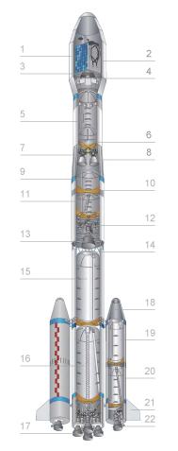
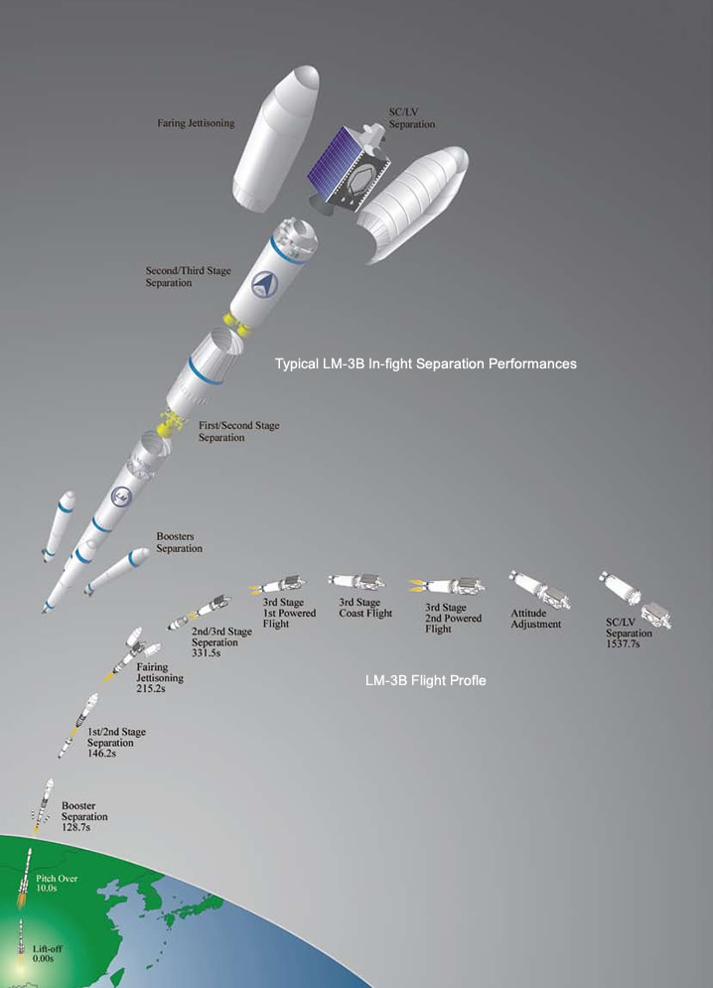
Launch Sequence
Long March 3B
1. Payload Faring 2. Payload 3. Payload Adapter 4. Vehicle Equipment Bay 5. LH2 Tank 6. LOX Tank 7. Inter-stage Section 8. Third Stage Engine 9. Oxidizer Tank 10. Inter-tank Section 11. Fuel Tank
12. Second Stage Vernier Engine 13. Second Stage Engine 14. Inter-stage Truss 15. Oxidizer Tank 16. Fuel Tank 17. First Stage Engine 18. Strap-on Booster Cone 19. Strap-on Booster Oxidizer Tank 20. Strap-on Booster Fuel Tank 21. Stabilizer 22. Strap-on Booster Engine
Courtesy of http://www.cgwic.com/LaunchServices/LaunchVehicle/LM3B.html

Slide 33
Launch Insurance
Assumes premium
rate of 8%
Launch
Separation
Completion of testing
TIME
30
Minutes
90
Days
Remaining 275
Days
4%
+2%
+2%
Launch phase
Testing phase
In-orbit phase
Launch Vehicle Flight Only
Estimate of what is purchased
2%
Launch + 6 months
2%
96%
Launch + 12 months

Slide 34
Launchers
Main launch vehicles:
Ariane 5
Vega
Soyuz
Proton
Sea Launch
Falcon 9
Long March 3B

Slide 35
In-Orbit Insurance

Slide 36
In-Orbit Cover
Wording negotiations tend to be concise compared to protracted launch insurance negotiations
Insurers of the launch programme tend to be approached first
Rates are presently in the region of 0.25 – 1.3% for 12 months cover
Insurance Capacity is high which is causing rates to fall

Slide 37
In-Orbit Cover Drafting Considerations
Follow the same wording as used for the launch insurance but remove the “launch” references removed
Basis of cover is the same
(
)
Available Communications Capacity
x
1-
Amount of Insurance
Stated Communications Capacity
Calculation based on available transponder years
Transponder years based on original life and remaining satellite life

Slide 38
Third Party Liability Insurance

Slide 39
Third Party Liability Insurance
Basis of cover is to protect insured parties from liability for damage caused by space related activities
Risk of loss attaches at INTENTIONAL IGNITION and terminates after a specified period (usually 12 months)
Cover is for the consequences of an occurrence, typically “to indemnify the Insured for all sums that it becomes legally obligated to pay due to an occurrence that causes personal injury or property damage to any third party”
Cost is relatively cheap (0.1%) because there are relatively few accidents
Launch service providers offer under the launch service agreement

Slide 40
Third Party Liability Insurance
Launch service providers need the cover in any event so offering it as an additional benefit under the launch services agreement serves 2 interests
Launch service provider has control over the contract, which means it can tailor cover to suit its requirements
Launch service provider gets a contribution towards the insurance costs through launch service price
Launch service providers provide different limits
Arianespace EUR64m
Proton USD100m
Sea Launch USD100m
Problem arises when state issuing the launch license requires a higher limit than launch service provider

Slide 41
Accidents

Slide 42
Space Weather and Radiation
Covered under a standard launch policy
Solar flares may affect components
Satellites are built to withstand
Galaxy 15 (‘ZombieSat’) affected by flare on 5 April 2015
Came back on line 23 December 2015

Slide 43
Collisions in Space
Geostationary orbit
All in the same direction
Low Earth Orbit
Iridium 33 / Cosmos 2251
https://www.youtube.com/watch?v=_o7EKlqCE20
Collisions with foreign bodies
JAXA Hitomi satellite

Slide 44
Debris
Ongoing problem
Bigger problem in LEO
Cascading effect
Prevent all launch activity
What to do?
Capture and de-orbit
Vaporise
More control?
https://www.youtube.com/watch?v=tN_CvGJKMOs

Slide 45
Accidents Involving Expendable Launch Vehicles
Re-contact events are covered
Should be limited to immediate events
Cover for damage to the satellite
Most incidents are on the ground
Cover for damage caused by the launch vehicle

Slide 46
Interference with Satellite Signals
Jamming
Not covered under asset policy
Covered under a loss of revenue policy
Cyber attack is a grey area
Damage could be covered
Terrorist attack would be excluded
State attack probably excluded
Hacker not specifically excluded

Slide 47
Human Space Travel
Distinction between orbital and sub-orbital travel
Orbital = Space
Sub-orbital = aviation
Formerly the domain of governments but now moving into commercialisation
Sub-orbital flights
Virgin Galactic
Passenger or Participant
Liability for death or injury

Slide 48
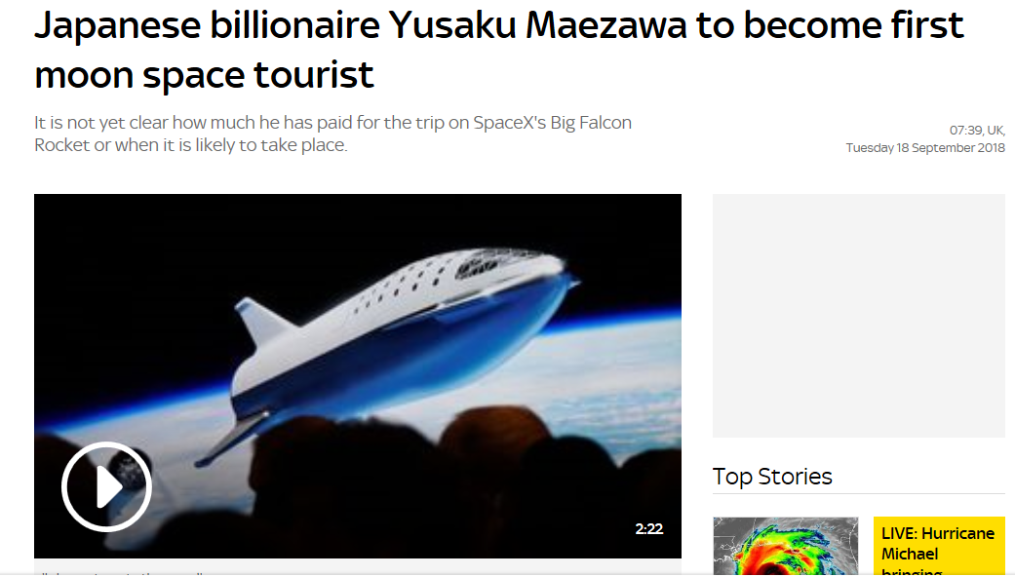
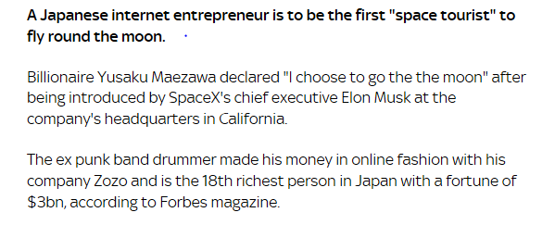
Human Space Travel
Courtesy Sky News

Slide 49
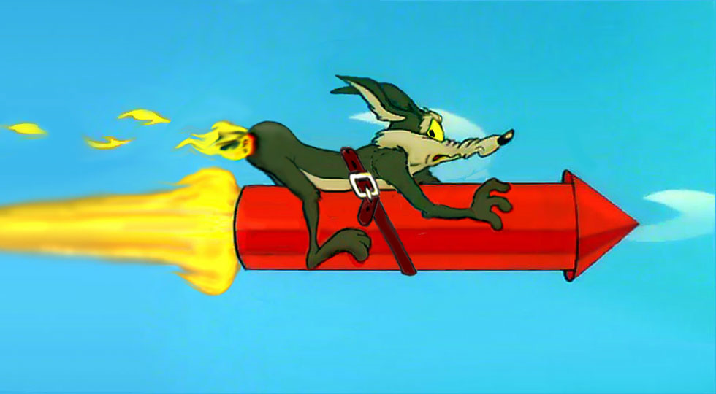
Human Space Travel
Can you insure?
If not excluded = Insured?
Seriously material change to the risk
Oh no …! his Insured Consent Form is in his back pocket
“Getting on a space flight is a material change in risk,” he said, akin to strapping rocket boosters onto a car and asking for a new policy. “Put yourself in the place of the insurer. Would you charge the same premium?”

