Slide 1
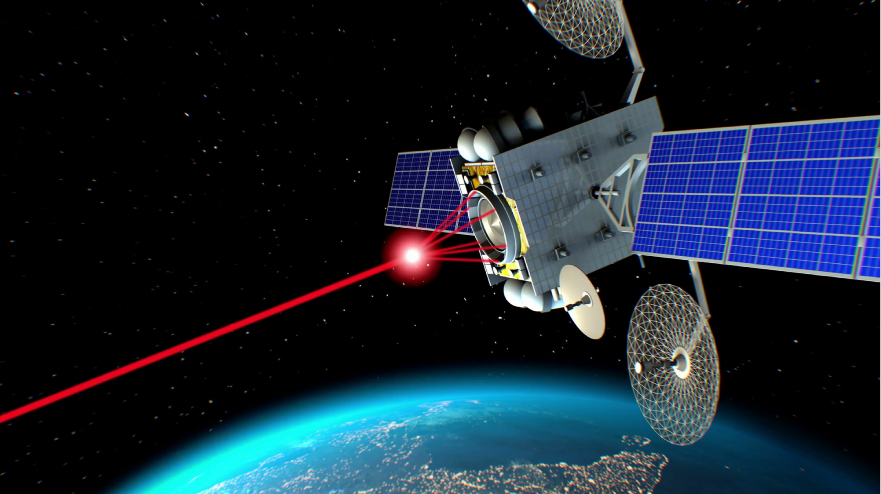
MILITARY AND SECURITY USES OF SPACE
Mark Roberts
15 October 2019

Slide 3
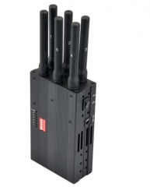

Slide 4
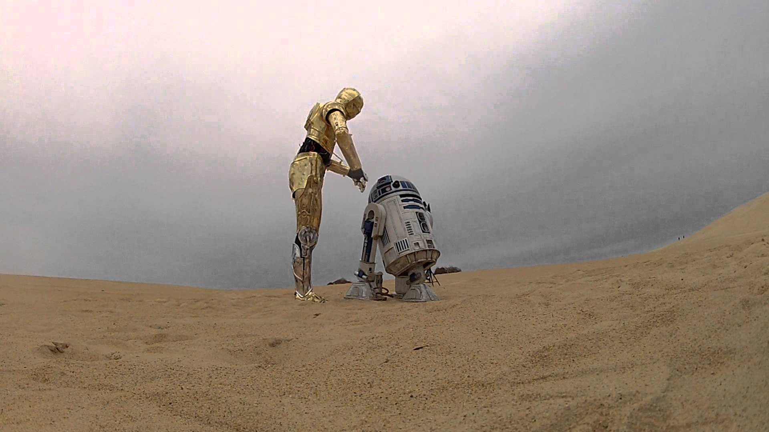
Robotics

Slide 5
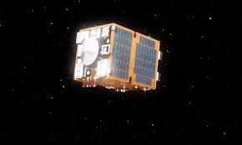
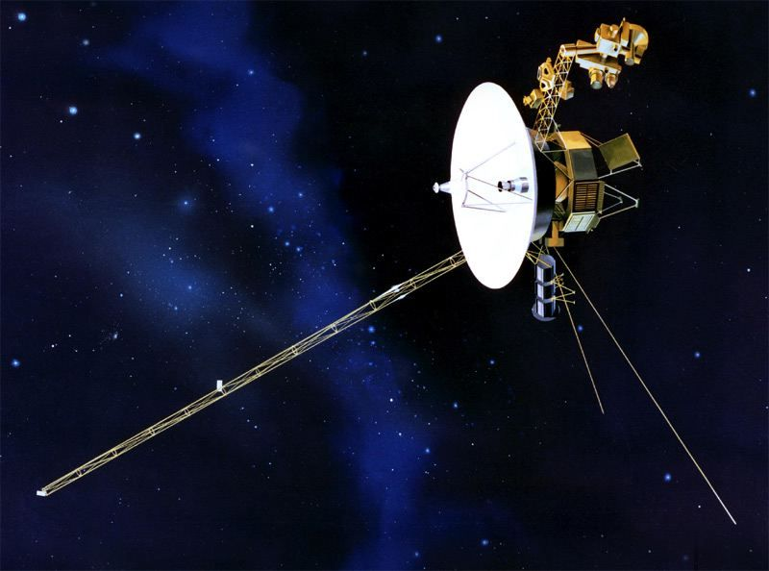
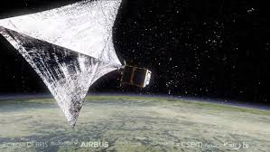
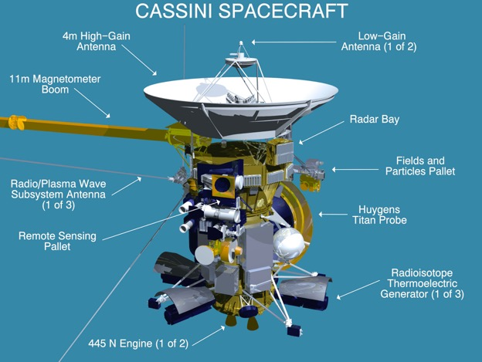
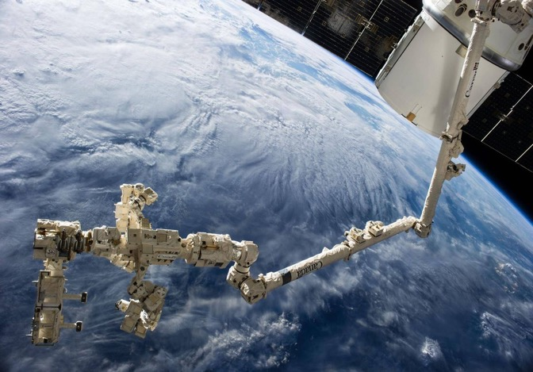
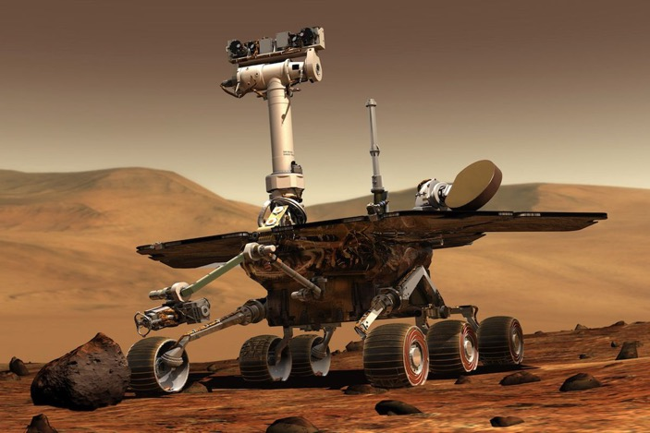
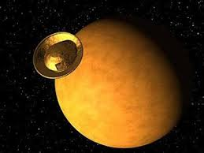
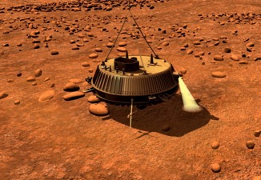
Space Robots
Capable of surviving environment
Performing exploration
Construction, maintenance, servicing
Designed to be multi-tasking
Cheaper the humans
Controlled ‘locally’ or ‘remotely’ from earth
Future (actually now)
Autonomy and AI
Navigation/path planning
Task sequencing
Task perfection

Slide 6
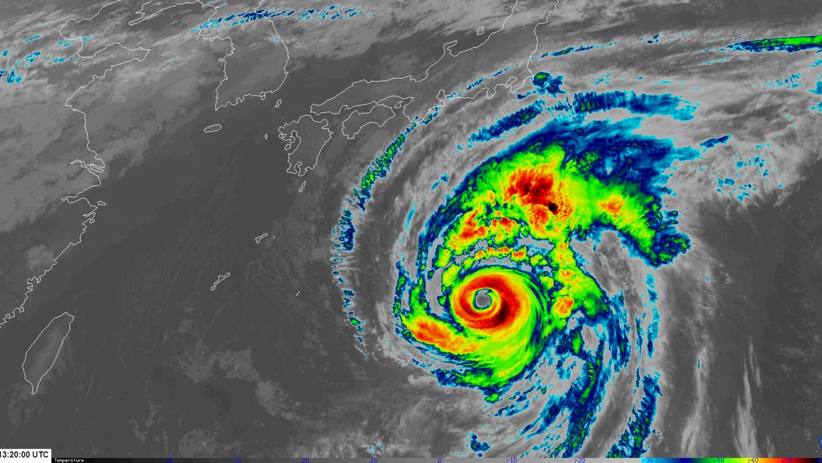
Environmental Monitoring
Atmospheric Characterisation
Oceanic Characterisation
Space Characterisation
Land Characterisation
Civil-Military

Slide 7
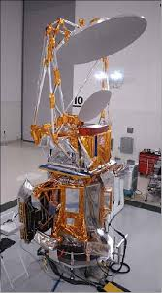
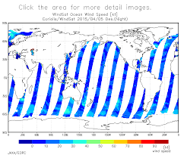
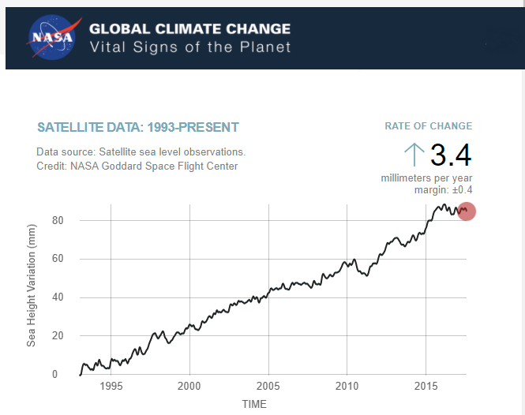
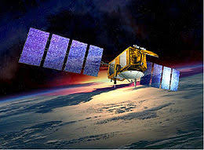
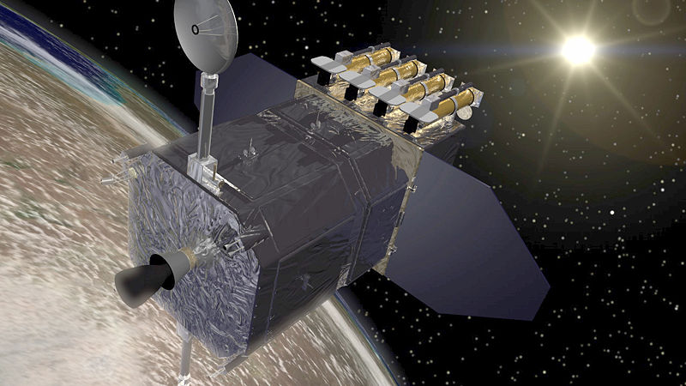
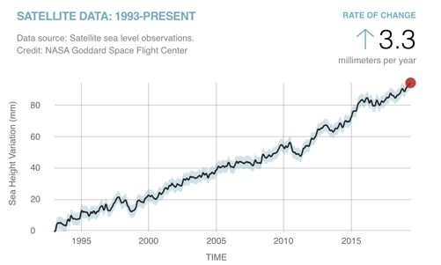
Atmospheric Characterisation
Wind – WindSat – Microwave
Comms/Nav Outage Forecasting
Oceanic Characterisation
Sea Levels – Jason 2 - RAlt
Space Characterisation
Flares / Radiation
Anomaly resolution

Slide 8
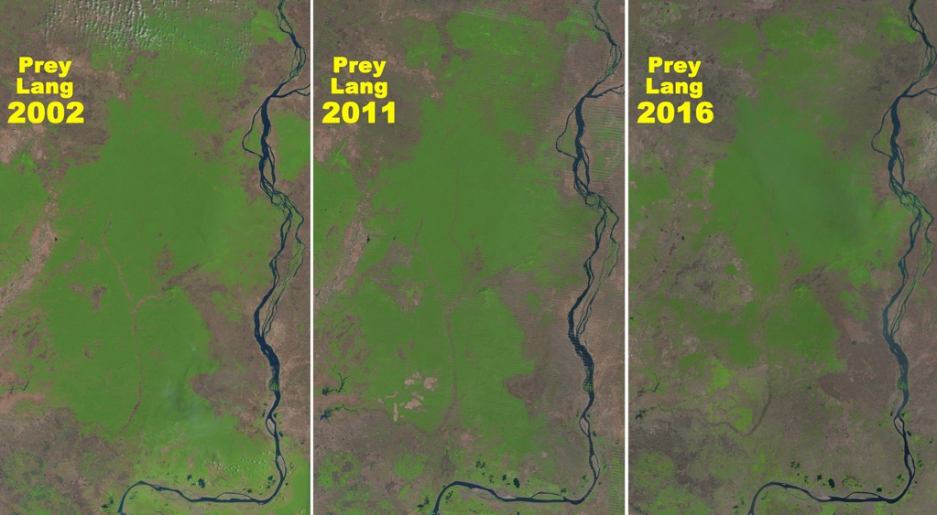
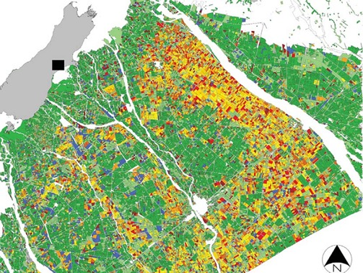
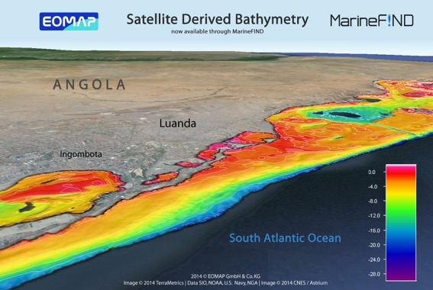
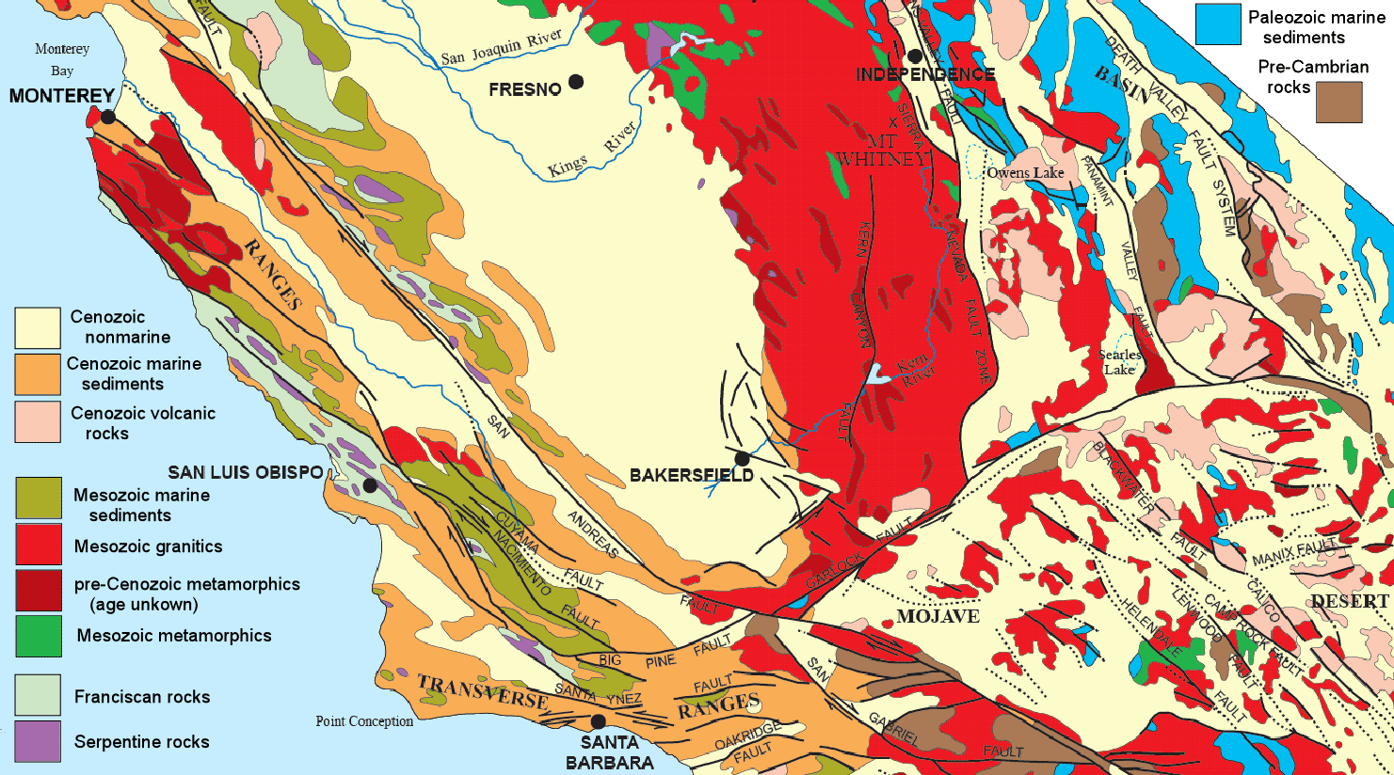
Land Characterisation
  Agriculture / Land use
  Hydrography
  Geology
  Mineralogy
  Land use

Slide 9
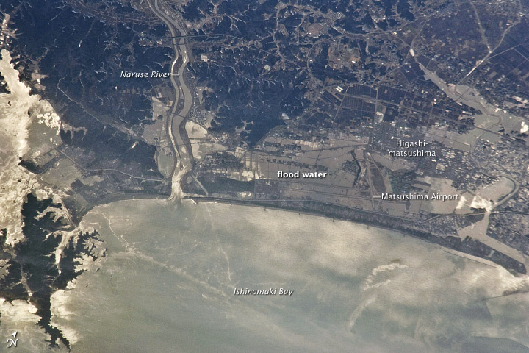
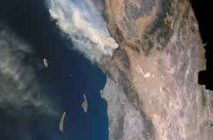
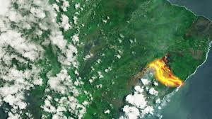
Civil-Military
Forest Fires
Tsunami Flooding
Volcanic Activity

Slide 10
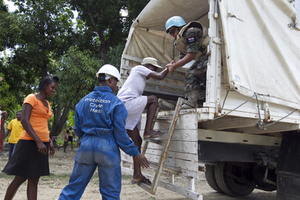
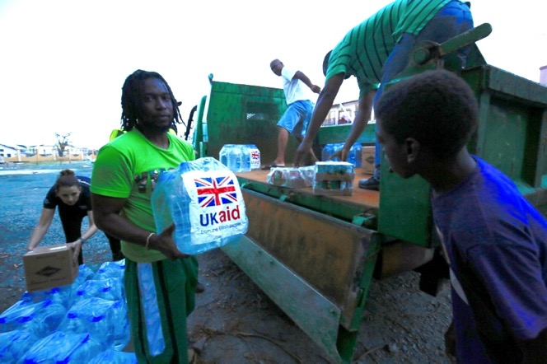
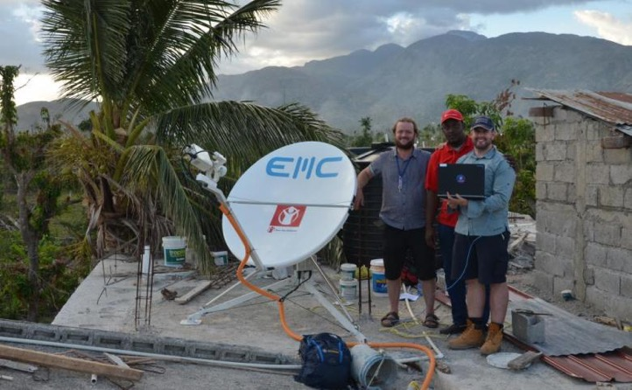
Humanitarian
Remotely sensed data
Communications
Logistical planning
Rapid decision-making
Resource allocation

Slide 11
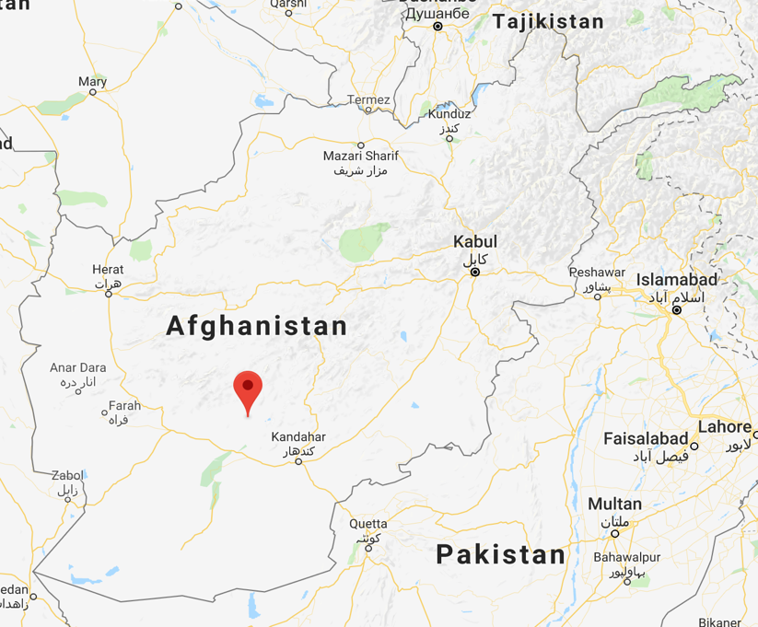
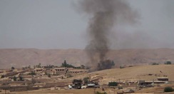
Military Use of Space – A Story
Preparation:
SatCom

Slide 12
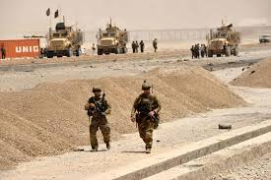
Military Use of Space – A Story
Preparation:
SatCom
In Country C⁴
ImInt
ComInt
SigInt

Slide 13
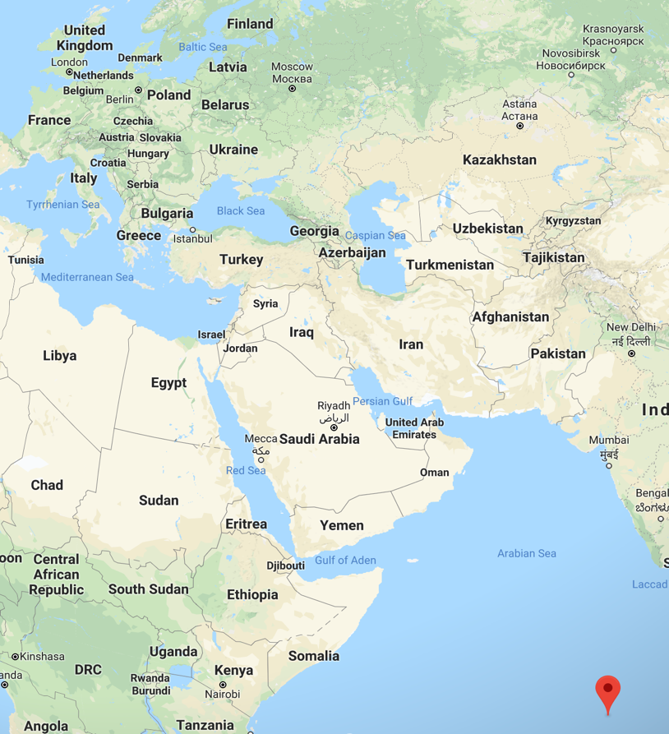
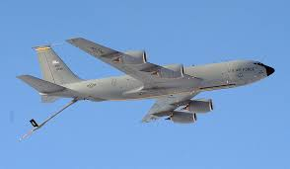
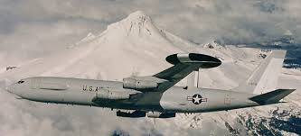
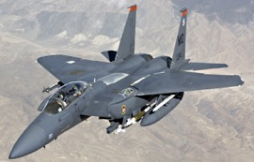
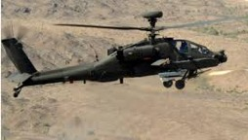
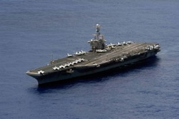
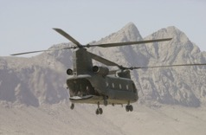
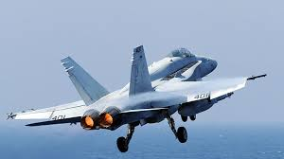
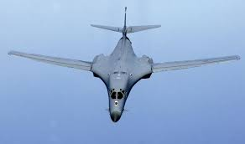
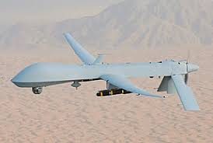
Military Use of Space – A Story
Preparation:
SatCom
Intra & Inter Theatre C⁴
ImInt
ComInt
SigInt

Slide 14
Military Use of Space – A Story
Operation:
SatCom
Intra & Inter Theatre C⁴
  Command
  Coordination
  Control

Slide 15
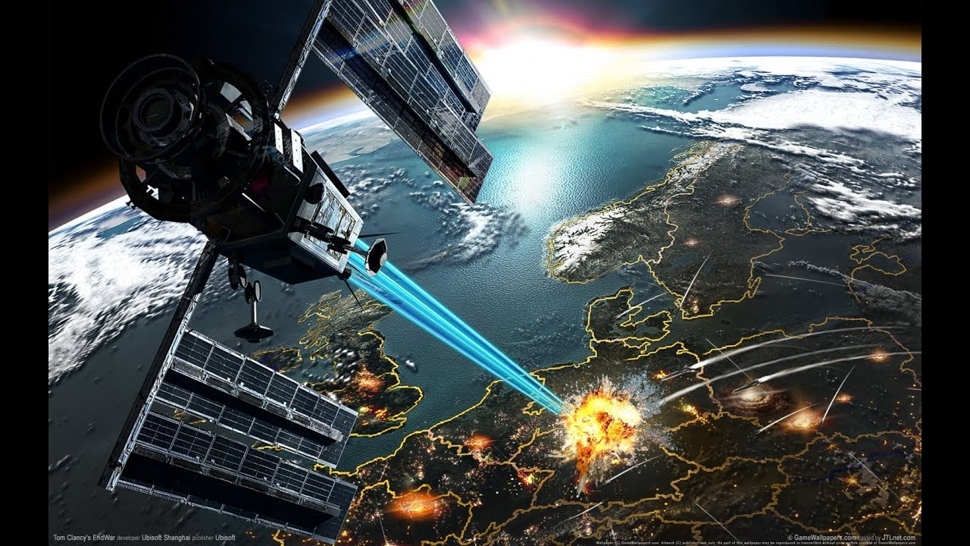
Weaponisation of Space
Cyber?!
ASAT Missiles
On-Orbit Kinetic Actions
DEW
Blinding

Slide 16
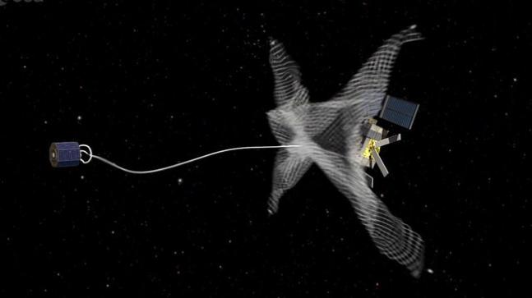
Is This A Weapon?
Thank You

