Slide 1
The Legal Regime
Session 3

Slide 2
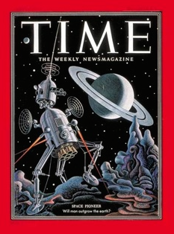
Legal Background
Early activities by governments
Natural that public international laws govern
US and USSR could have had bilateral agreement
Need to involve other states since they are affected
Multi-lateral agreement through the UN
Ad hoc COPUOS formed 1958, Permanent 1959
Members 18 to 24 members – now 92 1952 Space Pioneer:
[Cyprus, Ethiopia, Finland, Mauritius & Paraguay] Will man outgrow the Earth?
STSC and LSC
Cooperation
Apollo Soyuz Test Project docking 1975 – ISS Contribution

Slide 3
Sources of Space Law
International Law
Public International Law
Private International Law or Conflicts of Law
Commercial International Law
cf Municipal Law
Sources
Treaties and Conventions
General international law - recognised principles of law ICJ Statute Art 38(1)
Judicial Decisions (secondary)
Teachings of Leading Scholars (secondary)
Multi-lateral Agreements

Slide 4
UN Resolutions
Resolution 1962 (XVIII), Declaration of Legal Principles Governing the Activities of States in the Exploration and Use of Outer Space
Established the main principles
Peaceful use
Benefit of all mankind with equality among States
Avoidance of harmful activities
State responsibility and liability
Non-appropriation
Co-operation
Adopted 13 December 1963, later incorporated in OST 1967

Slide 5
Space Treaty Operation
International scope
Treaties binding on States
OST articulates the general principles
Other treaties and conventions more specific
In some jurisdictions treaties are self implementing
Municipal laws implement OST and apply to operators
Several countries have laws governing certain aspects
Some only establish an agency

Slide 6
UN Treaties
Five international UN treaties
1967 Outer Space Treaty – Principles Treaty [109]
1968 Rescue Agreement [98]
1972 Liability Convention [96]
1975 Registration Convention [69]
1979 Moon Agreement [18]
Moon Agreement in force 1984
18 ratifications. None of the major space active States. Excludes Brazil, China, France, India, Japan, Russia, UK and USA. Includes Australia, Austria, Belgium, Mexico and Netherlands

Slide 7
Principles of Space Law
Peaceful Use
States party to the OST are bound by its Preamble, with many references to peaceful use of outer space. Vienna Convention Art 18
Exclusively peaceful use of celestial bodies. OST Art IV
Non-appropriation
Outer space, including the Moon and other celestial bodies, is not subject to national appropriation by claim of sovereignty, by means of use or occupation, or by any other means. OST Art II
No State can claim any part of space or exclude others from access and use of space.
Freedom of over-flight and peaceful use.

Slide 8
Principles of Space Law …Continued
Common Interest and Cooperation
Exploration and use of outer space, … shall be carried out for the benefit and in the interests of all countries, irrespective of their degree of economic or scientific development, [without discrimination … on a basis of equality] and in accordance with international law and shall be the province of all mankind.
There shall be freedom of scientific investigation in outer space, … and States shall facilitate and encourage international cooperation in such investigation. OST Art I
Opportunity to other States to observe; Report results OST Arts X-XII
Apollo-Soyuz Test Project 1972 - 1975

Slide 9
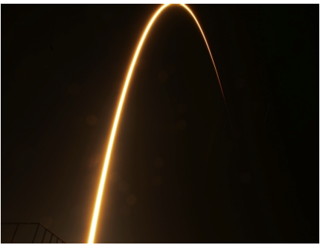
Soyuz to ISS
NASA Image

Slide 10
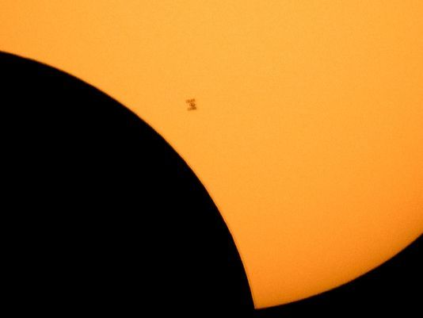
?
NASA Image

Slide 11
Solar Eclipse 21 Aug 2018
NASA Image

Slide 12
Principles of Space Law …Continued
Access
All stations, installations, equipment and space vehicles on the Moon and other celestial bodies to be open to representatives of other States, subject to consultation and advance notice OST Art XII
Non-Interference
Conduct activities with due regard to interests of other States
International consultation before any activity … that would potentially cause harmful interference with activities of other States. OST Art IX
Compliance with international law
Includes UN Charter. OST Art III

Slide 13
Principles of Space Law …Continued
International Peace and Security
Measures taken by nations and international organizations, to promote mutual survival, safety, co-operation and understanding. OST Art III
Distinguish security of the unique space environment to be used safely and responsibly by all, including the physical and operational integrity of manmade assets in space and their ground stations, as well as security on Earth from threats originating in space-based assets
Protection of Environment
Earth and Space. OST Art IX
State Responsibility
States are responsible for their national space activities and must authorise and supervise private space ventures. OST Art VI

Slide 14
Principles of Space Law …Continued
Non-Interference and State Responsibility

Slide 15
Responsibility
National Activity
States bear responsibility for national activities in outer space, whether carried on by governmental or non-governmental entities, and for assuring that national activities are carried out in conformity with the provisions in the present Treaty.
Activities of non-governmental entities require authorization and continuing supervision by the appropriate State. OST Art VI
International Organisations
Responsibility for compliance with this Treaty by an international organization, carrying on space activities, shall be borne both by the international organization and by the States participating in such organization. OST Art XIII

Slide 16
State Liability
Responsibility Distinguished
OST Art VII creates liability for space activities distinct from Art VI
Launching State internationally liable under Art VII even if not party to Liability Convention
Liability Convention elaborates international liability
Definitions
“damage”: loss of life or impairment of health; or loss of or damage to property of States or of persons, natural or juridical, or property of international intergovernmental organizations
“launching” includes attempted launching
“launching State”: (i) A State that launches or procures the launching of a space object; (ii) A State from whose territory or facility a space object is launched. Liability Convention Art I

Slide 17
Jurisdiction & Control
State of Registration
When a space object is launched into Earth orbit or beyond, the launching State shall register the space object by means of an entry in an appropriate registry which it shall maintain Reg Conv Art II
Jurisdiction
Jurisdiction and control of a space object vests in the registration State. OST Art VIII
The State can extend its laws to the space object and exercise control over it
For examples see IGA and US IP laws extended to ISS
Ownership
Not affected by presence in space or return to Earth. OST Art VIII

Slide 18
Comparing Legal Regimes
Air Law
National and international law regulating civil uses of airspace
Separate and Distinct - Aerospace Law
Airspace is under the sovereignty of subjacent states
Outer space governed as Province [Common Heritage] of Mankind
Aircraft safety and cross-border operation
Air-traffic control
Air Space and Outer Space Boundary
COPUOS discussions
Space transportation systems
Space Traffic Management – STM
Micro-satellites and Constellations
Improve tracking; Reduce population

Slide 19
Comparing Legal Regimes …Continued
Law of the Sea
Freedom of Access and Use
No Right of Appropriation or Sovereignty
Heritage of Mankind cf Province of all Mankind
Differences
Right of Exploration and Exploitation
Resources Vested in Mankind as a Whole
Freedoms to navigate, over-fly, lay cables & pipes, fish and do scientific research
International Seabed Authority Administers Resources

Slide 20
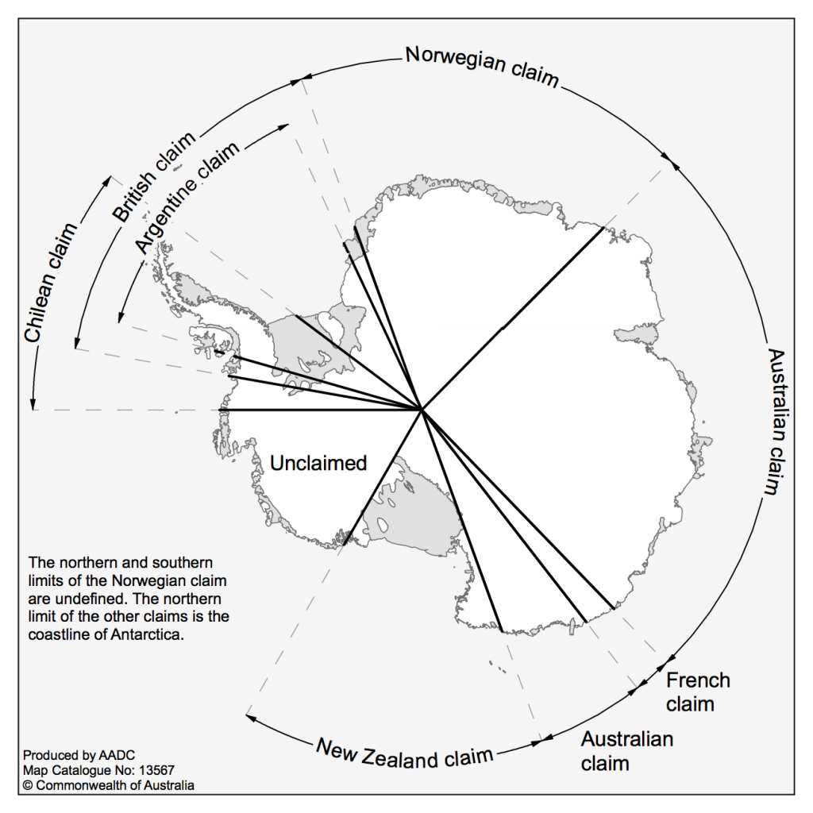
Comparing Legal Regimes …Continued
Antarctica
Peaceful Purposes and Ban All Weapon Tests
No assertion or denial of a claim
No New Territorial Claims post 1961
Cooperation and Right of Inspection
Result of experiments freely available

Slide 21
National Laws and Policies
Discharging International Obligations
Licensing
Supervision
Liability
Telecommunication
Implementing National Policy
Focus and terms of national laws vary
US most comprehensive
Administration of laws entrusted to different agencies, eg FAA-AST
Office of Commercial Space Transportation
Relationship with International Law

Slide 22
Developments of Legal Regime
State monopoly
Risky investment and security concerns
Increased private commercial element from 1980s
Telecom earliest private space service, articulated by Arthur C Clark in Wireless World, October 1945
Privatisation of Telecom, US breakup of AT&T
Space Commercialisation Act and Private Launchers
Upstream and Downstream
Infrastructure v. Applications

Slide 23
National Laws
Licensing and Authorisation
Some countries authorise each activity without licensing regime
Increasingly countries are adopting legislation and licensing schemes
Third party insurance and government indemnification – some limit
Spectrum assignment
Typical Requirements
Notification of the launch date and location
Payload and orbital characteristics
Consistency with State international obligations
National security
State’s liability for damages

