Slide 1
Space Policy
Session 2

Slide 2
Policy Formulation
Nature of Policy
Identify political priorities
Devise programmes and actions to deliver desired outcome
US and USSR
EU [Space for Europe, European Space in the World] and ESA
Influences
Science, Social and Economic Development
Defence, Intelligence and National Security
Policy vs Strategy
Policy is what is, or what is not done – implies a rule or guide
Strategy is the methodology used to accomplish a target prescribed by policy

Slide 3
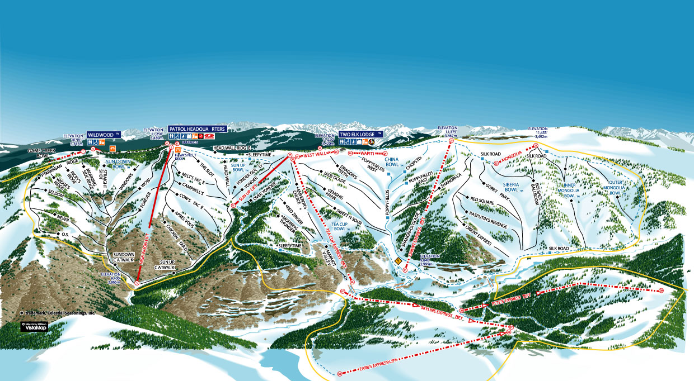
Options & Implementation

Slide 4
Policy Objectives
Motivation for Space Policy
Protect national interests (territorial, military, etc.)
Security (political, financial, personal - health, food)
Disaster Monitoring
Health
Economic growth & security
Weather Forecast
Agricultural Monitoring and Planning
Resource management
Technological development
Communication and Information technology
Scientific capacity
Education
National Prestige

Slide 5
New Policy Factors
Growing Focus on Space
Rapid Expansion of Activities
Increasing Numbers of Participants
Private Commercial Investors
Reducing cost of access
Wealth concentration
Developing countries
Coordination on Sustainability and Security
Sharing Risks and Costs
Earth Orbits
Congested, Competed and Contested
Safety, Security and Sustainability

Slide 6
Policy Institutions
UN COPUOS
LSC and STSC
Groups of Experts
Regional and National
European Commission
European Space Agency ESA
Asia-Pacific Space Co-operation Organisation APSCO
African Union
National Space Agencies NASA, JAXA, UKSA
IGOs with Specific Remit
Inmarsat, Intelsat, ArabSat and AfriSat

Slide 7
Policy Challenges
Treaty Adherence
Registration Convention
Weapons Control
Operator Diversity and Coordination
Differential Needs
Applications for Developing Countries
Industrial Policy
Public Support
Educate and Inform of Benefits
Government Sustained Funding and Investment

Slide 8
Constraints
Role of WTO
General Agreement on Trade in Services 1995 GATS
Basic Telecoms Agreement 1997 BTA
Arms Control
UN Conference on Disarmament
International Humanitarian Law
European Union
Competition Laws
State Aid
ESA juste retour
Case No COMP/M.5168 – EADS/ SSTL

Slide 9
Space Policy Regime
Space Policy and Law Course 2019
Space Policy Principles, National and International Institutions
James Cemmell
Government Engagement V-P, Inmarsat; ISPL Faculty
14 October 2019, London
London Institute of Space Policy and Law

