Slide 1
Space Environment & Technology
Space Policy and Law Course 2019
Characteristics of Space, its Use, and Space Objects.
Dr Gerry Doyle
Raytheon Systems Ltd – Cyber, Space and Intelligence Team
October 2019, London
London Institute of Space Policy and Law

Slide 2
The Space Environment and Space Technology: Orbits and Spacecraft
(or…The consequences of physical laws for space lawyers (and everyone else!))

Slide 3
Gerry Doyle
Recently retired from regular RAF service
Now a Programme Manager with Raytheon UK, and Reservist with 600 Sqn RAuxAF, RAF Northolt.
Illustrations from UK Military Space Primer (DCDC, 2008-10) (free online: https://www.gov.uk/government/publications/the-uk-military-space-primer ).
Feedback encouraged.

Slide 4
Outline
The Space Environment.
Orbital Motion and Kepler’s Laws.
Satellites and orbits:
Belts or bands of orbits.
Ground tracks.
Missions and orbits.
A few words about launch and launch sites.
Notes:
A lot of ground to cover in 90 minutes. Slightly unsure of level to pitch at – if I’m talking down, please ask me to up the level a bit.
Very quick view of the space environment
The unique nature of orbital motion – one of the defining characteristic (the defining characteristic?) of space – which might be helpful as a definition.
Kepler’s laws regulate spaceflight – an extension of Newtonian motion (actually historically, a precedent…)
How to get from abstract rules to concrete consequences – not often understood.
(For pragmatic reasons), the bands that orbits occur in.
Then put it together – how do orbits relate to the surface of the (rotating) Earth?
And how does that then dictate what you can and cannot do.
Finally (may be a casualty of time) – launch sites and the orbits you can reach from them).

Slide 5
The Space Environment
Airless. (= hostile to life and to equipment)
Radiation – solar and other. (= hostile to life and equipment)
Temperature Extremes. (= hostile to life and equipment)
Debris – natural and artificial. (= hostile to life and equipment)
Inaccessible – launch is stressful and hazardous, repair or resupply is challenging.
Notes:
Space is a challenging environment to operate in (so people must really want to get there)
Airless – life risks, equipment risks
Radiation (some protection from the Earth’s magnetic field – but not much)
Temperature – unmitigated solar radiation and deep cold of space – and intermittent shadow in some orbits.
Accessibility (not mentioned above) – challenge to repair, replenishment, launch is hazardous and an extreme environment in its own right.

Slide 6
Defining Space
There is no legal definition of space… But we can arrive at a pragmatic one (there are also arbitrary definitions).
Aerodynamic flight (aviation) relies on lift from the craft’s shape moving through the atmosphere, and usually on thrust from air-breathing engines.
Orbital motion is different– continuous flight around the Earth, without thrust, in a (relatively) stable path.
But only if you can get above the atmosphere. Otherwise drag/friction/air resistance burns you up or slows you down.
So space is the altitude where orbit becomes possible. ‘Beyond the atmosphere?’ – but the atmosphere has no ‘hard’ boundary.

Slide 7
Orbital Motion
Things fall towards the centre of the Earth (vertically) in a predictable way.
If a falling object is also moving across the surface of the Earth (horizontally), its path is a smooth curve.
If it is moving fast enough, its path matches the curvature of the Earth’s surface.
So although it is falling towards the Earth, the Earth’s surface is falling away from it at the same rate, and it never reaches the surface. This is orbital motion.

Slide 8
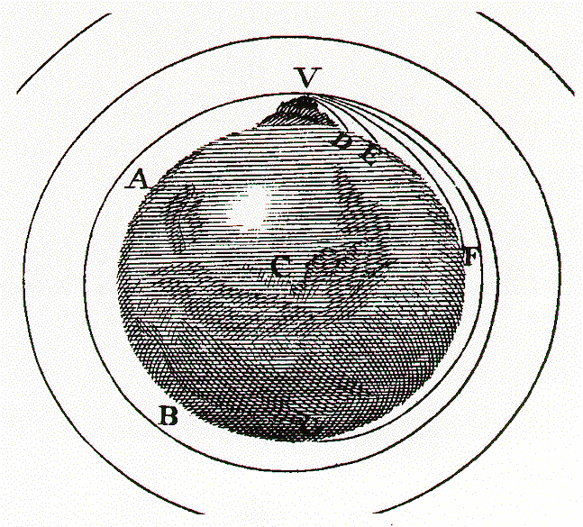
The Cannon on the Mountain
Newton (c 1687)
Period of orbit close to Earth’s surface 84 mins, implies 5 miles (8 km) per second forward speed.
Notes:
Newton knew his model was impractical, but in theory it was sound, and it could be analyzed using calculus and Newtonian mechanics.
84 minute period

Slide 9
Practical Orbits?
Where does orbital motion become possible?
Above about 200 km, short duration orbits (days/weeks).
Around 300 km, fairly stable orbits possible.
Atmospheric drag/friction insignificant above about 500 km.
Notes:
We talk as if we can define space – we can’t legally... (yet).
Maybe it’s where the atmosphere ends – sadly that doesn’t work – air thins continuously with altitude, and the atmosphere varies in thickness anyway (with solar activity cycle).
10000ft – limit of comfortable breathing
40000ft – commercial aviation – too thin to breathe, but supports flight
60-80000ft – military aviation – limiting case for flight – but plenty of atmosphere left (66 000 ft – end of regulated airspace (by Convention))
80km (= 80 000m = 262 500ft) USAF/NASA astronaut wings
100km (328 000ft) (x10 airliner cruise) – Karman line – FAI proposed definition.
150km (492 000ft) – lowest publically claimed sustained orbit (‘Zenit’)
350km – roughly ISS altitude (~1.15 million ft, ~30 times the airliner) – typical low earth orbit.

Slide 10
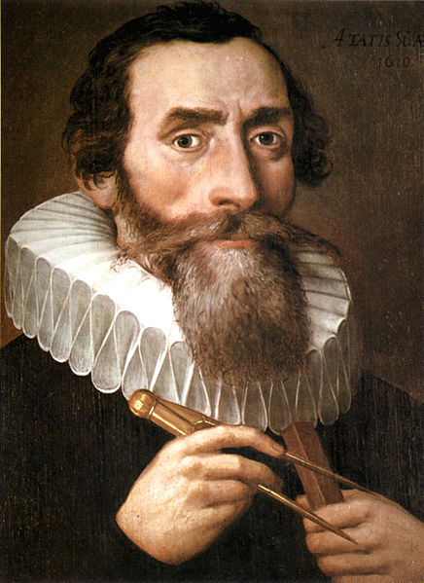
Johannes Kepler (1571-1630)
Began as assistant to Tycho Brahe (d 1601) working on planetary orbits.
Acquired Brahe’s observations and tried to make (empirical) sense of them.
Arrived at “Kepler’s Laws”.
(and defended his mother from charges of witchcraft during 1620-21!)
Notes:
Newton working 1660-1690.
Kepler predated Newton – c 1600-1610
Tycho Brahe (died 1601) had attempted to measure planetary positions – based on a sun-centric, circular model.
As accuracy of measurements improved, flaws in the circular assumptions became apparent.
Kepler had been Brahe’s assistant.
Tried to make empirical sense of Brahe’s measurements

Slide 11
Kepler’s Laws
Laws derived for planetary orbits around the Sun – but applicable to any gravitational orbit (though Kepler didn’t know this…):
Orbits are ellipses with the Sun (central body) at one focus.
The radius vector sweeps out equal areas in equal times.
Semi-major axis and period are linked (r³ α t²).

Slide 12
Ellipses
Minor Axis
Major Axis
X
X
Focus
Focus

Slide 13
Ellipses
Symmetrical (rugby ball, not egg)
Drawing board – two pins, loop of string
A circle is a special case of an ellipse (as a square is of a rectangle)
Eccentricity ‘e’. e=0, circle. e<1 ellipse, e=1 parabola, e>1 hyperbola

Slide 14
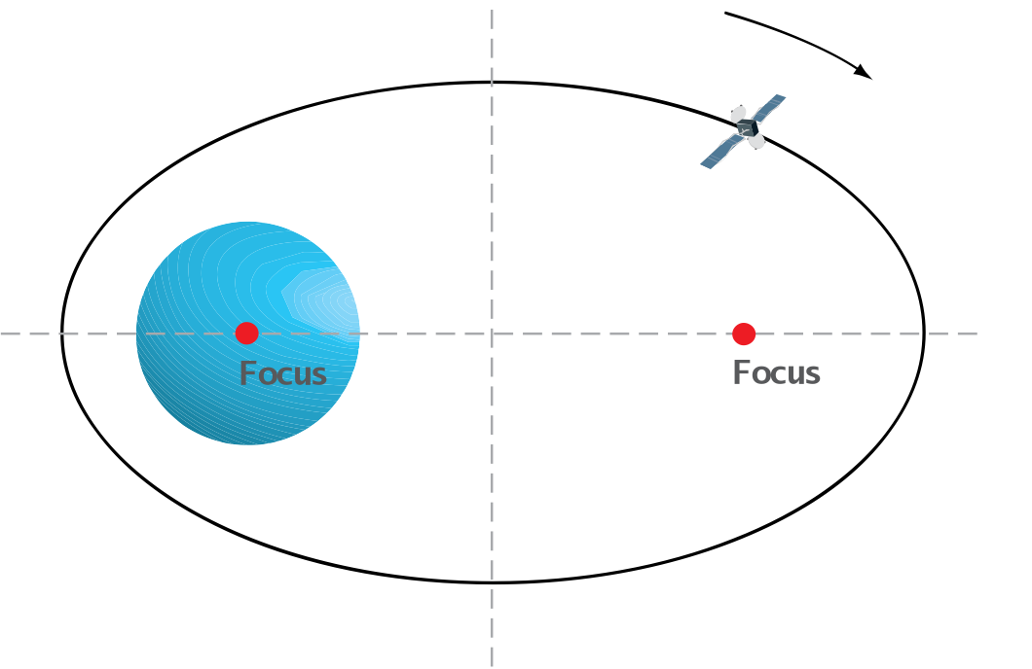
Kepler’s First Law
Notes:
Orbits are ellipses with the (centre of the Earth) at one focus – nb it is the CENTRE – implications will follow.

Slide 15
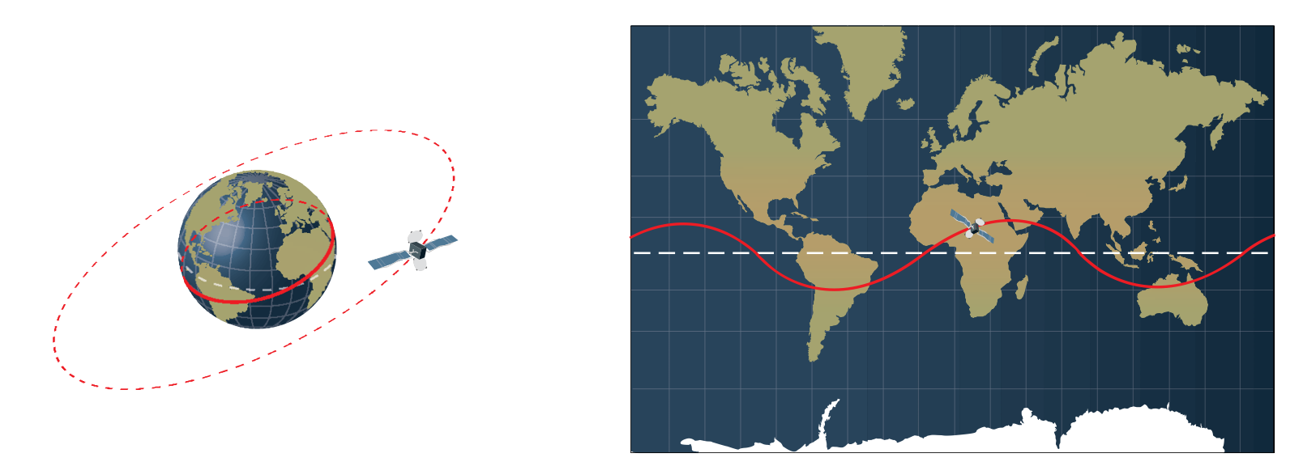
Kepler 1 - implications
Since the orbit includes the centre of the Earth, it either lies directly above the equator, or has parts North and South of it.

Slide 16
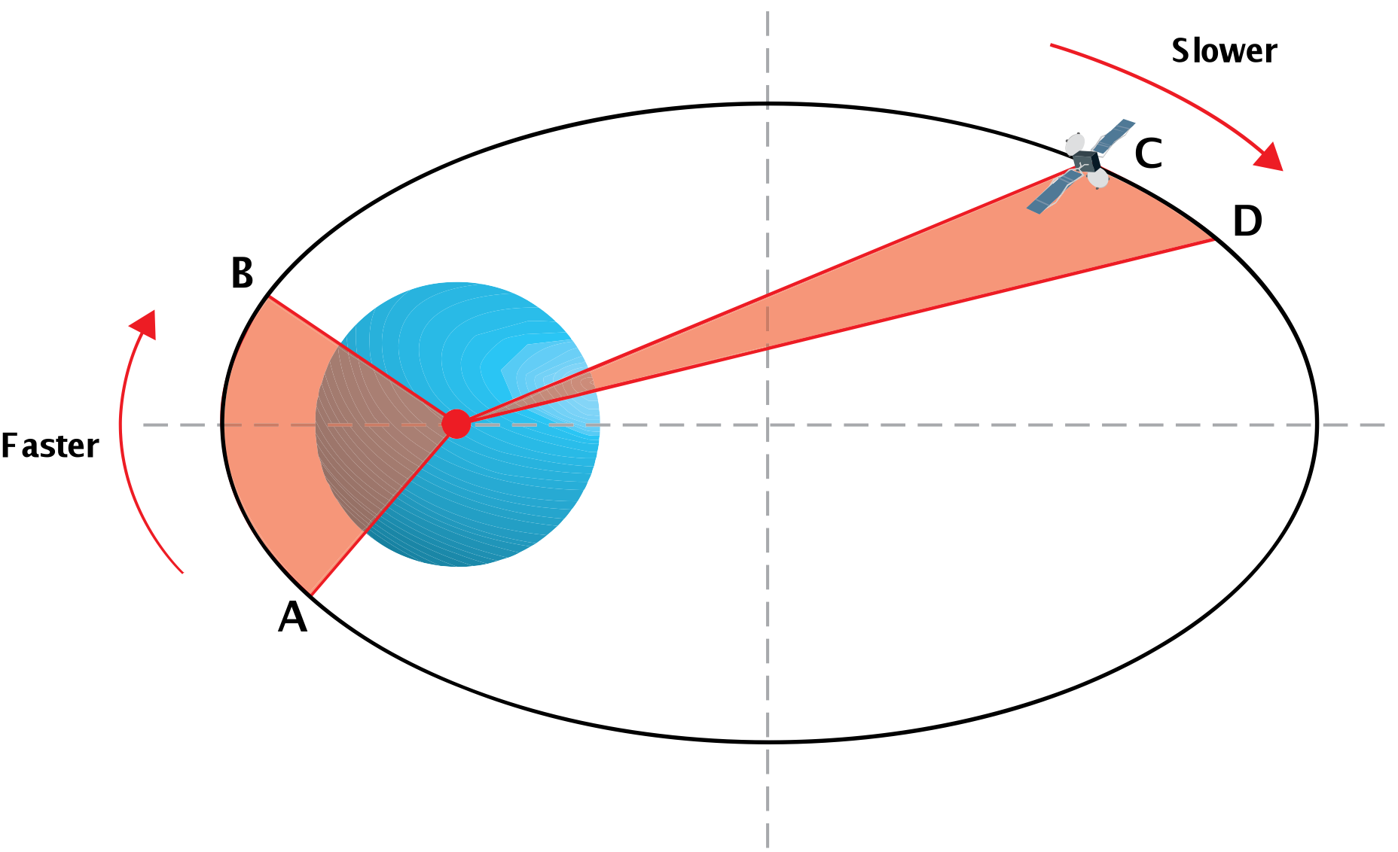
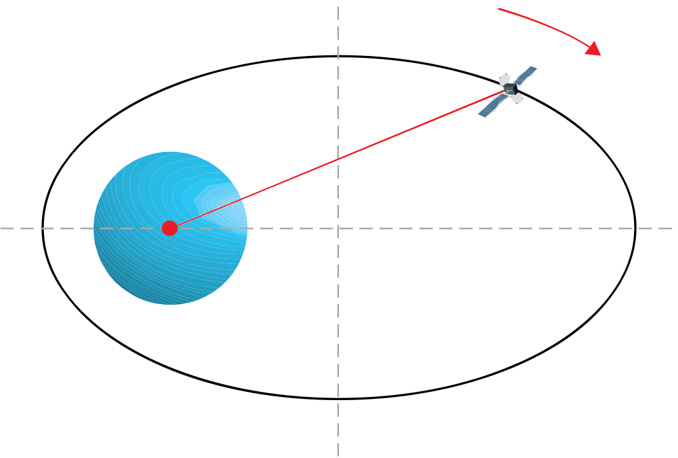
Kepler’s Second Law
The radius vector sweeps out equal areas in equal times.
Notes:
‘The radius vector sweeps out equal areas in equal time’
Actually describes how the speed of the satellite varies going round the orbit – for an elliptical orbit, the satellite will move faster at perigee than at apogee.

Slide 17
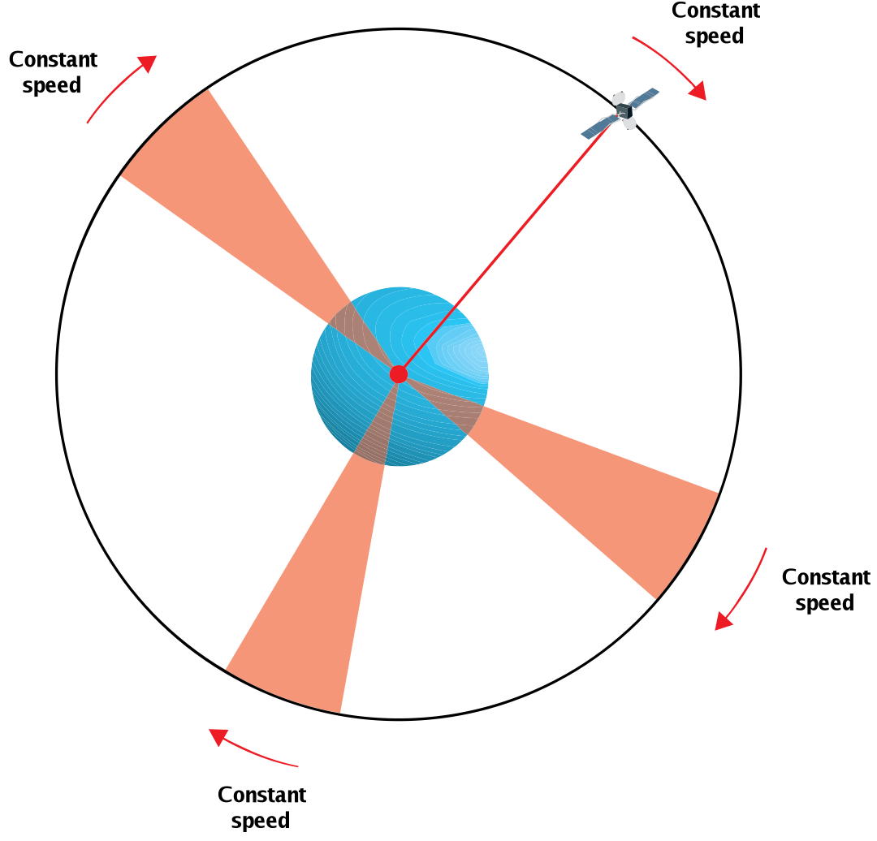
Kepler 2 - Implications
The radius vector sweeps out equal areas in equal times.
Notes:
We don’t really worry about the radius vector, just note that the speed of the satellite at any point on an orbit is fixed for that orbit – so two satellites in the same orbit cannot overtake.
And for circular orbits (low Earth orbits are invariably nearly circular), the speed is a constant. You cannot linger over ‘interesting’ places or speed up over ‘uninteresting’ ones.

Slide 18
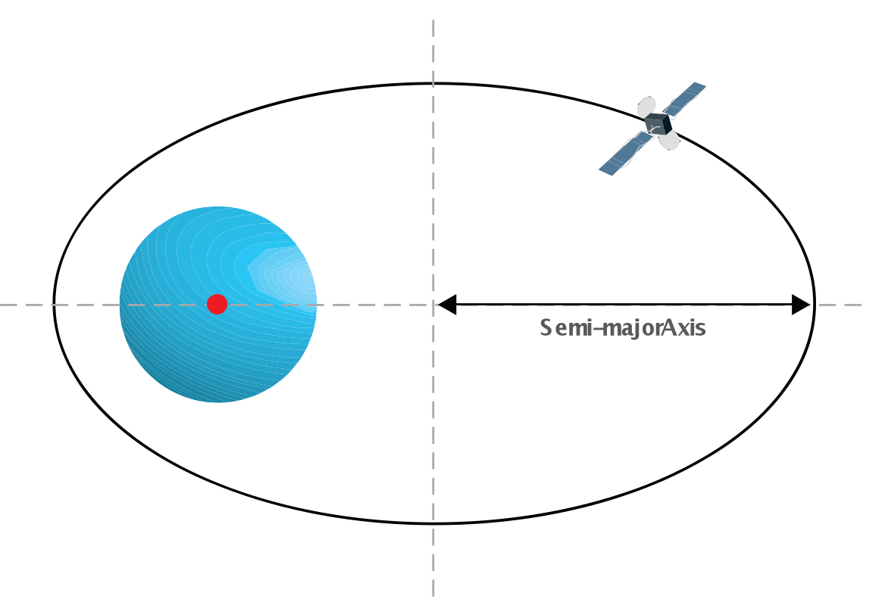
Kepler 3 - Implications
Semi-major axis and period are linked
Notes:
Square of the period varies with the cube of the semi-major axis
Implies that the further you are from the Earth, the longer the period, and that for each orbit there is only one possible period.

Slide 19
ANY QUESTIONS ABOUT KEPLER?

Slide 20
Orbital Belts
Low Earth Orbit (LEO).
200-1200 km altitude? t=90-120 mins
Medium Earth Orbit (MEO).
20 200 km altitude. t= 12 hours
Geostationary Orbit (GEO).
35 800 km. t=24 hours
Highly Elliptical Orbits (HEO).
various
Notes:
Exist for pragmatic reasons, not for any physical limits (other than sufficient altitude to clear the Earth’s surface).
Simple energy considerations mean that it is easier to launch less massive satellites than more massive, and easier into low-earth orbit than higher.

Slide 21
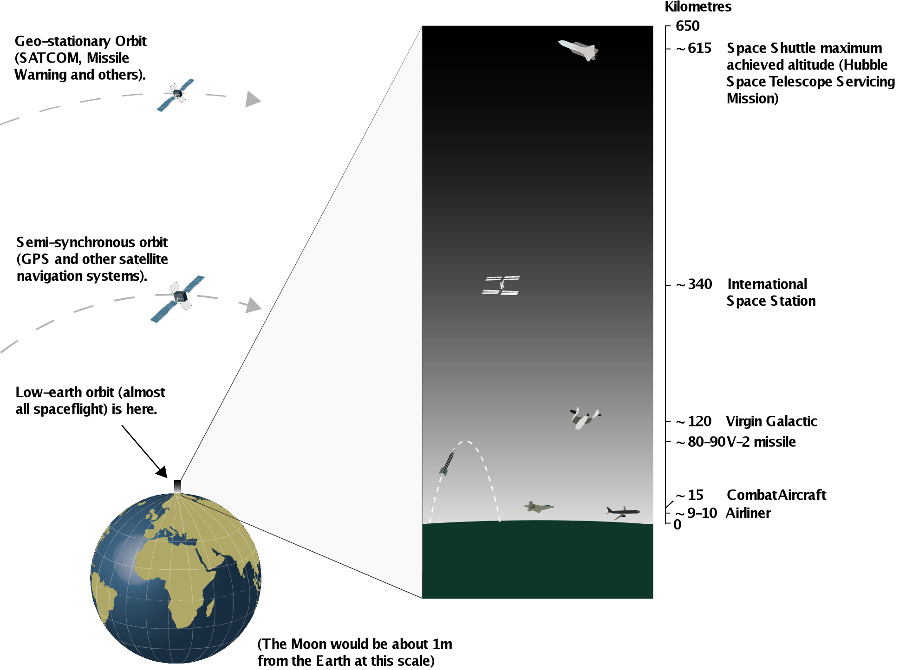
Orbital Belts (to scale)
Notes:
The LEO belt is very close to Earth – “if the Earth was a peach, LEO would be in the fuzz”
GEO is just over 5 Earth radii above the surface

Slide 22
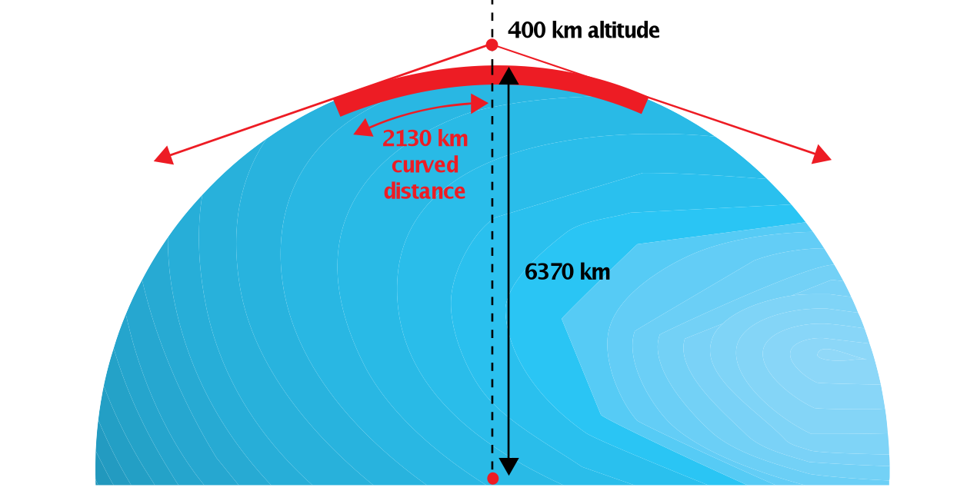
Fields of View - LEO

Slide 23
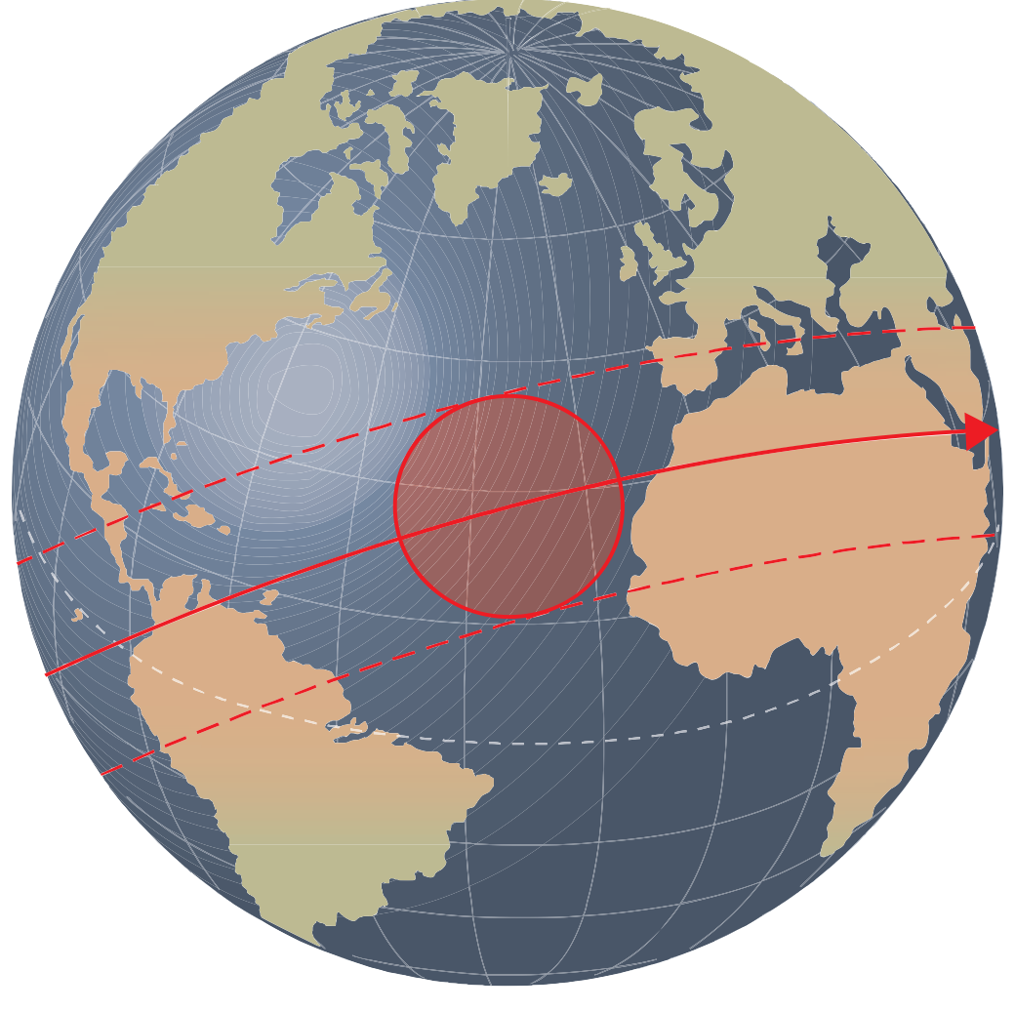
Plan view (same altitude)
Notes:
The circular footprint is moving continuously, and anything at the edge is only fleetingly in view.
At typical LEO altitudes, the longest ‘pass time’ is only 7 or 8 minutes.

Slide 24
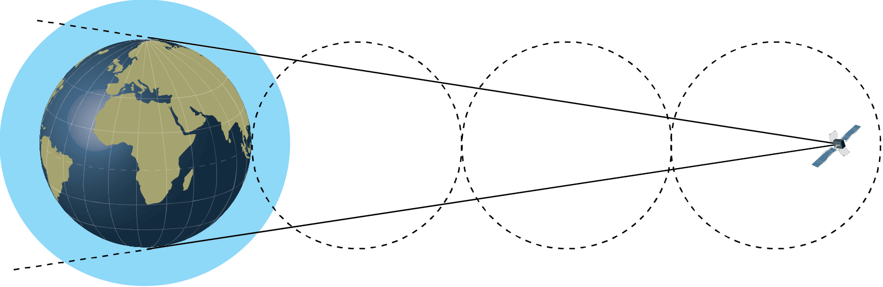
Field of View - GEO
Notes:
Even at GEO, you can’t quite see half of the Earth.
Note that at the poles, the satellite is only barely above the horizon, and is seen through a thick slice of the atmosphere.
Imagine this as a plan view, and you need a minimum of 3 satellites for global coverage.

Slide 25
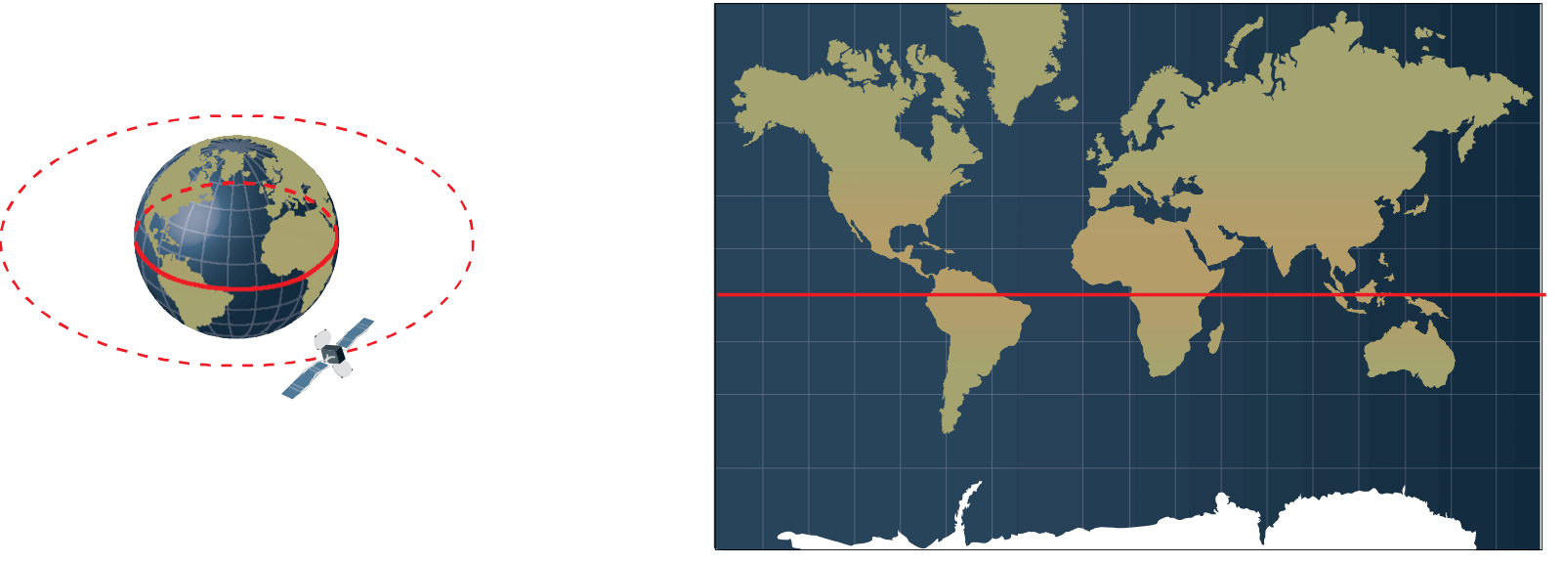
An Equatorial Orbit
Notes:
Simplest case – inclination is zero, the track is over the equator, the satellite probably overtakes the Earth. The ground track repeats endlessly.
If the orbit is notably elliptical, the rate of overtake will vary. You could hold position or even go ‘backwards’ briefly.

Slide 26
A Circular Inclined Orbit
Notes:
You have seen this picture before.
Let’s say the orbit is circular, LEO, and inclined at 20 degrees.
Equal portions above and below the equator.
No guarantee that the ground track will repeat – probably it won’t. It depends if the period divides into 24 hrs evenly.
The ground track is constrained by the inclination. At 20 degrees inclination, the satellite goes no further north or south than 20N or 20S.

Slide 27
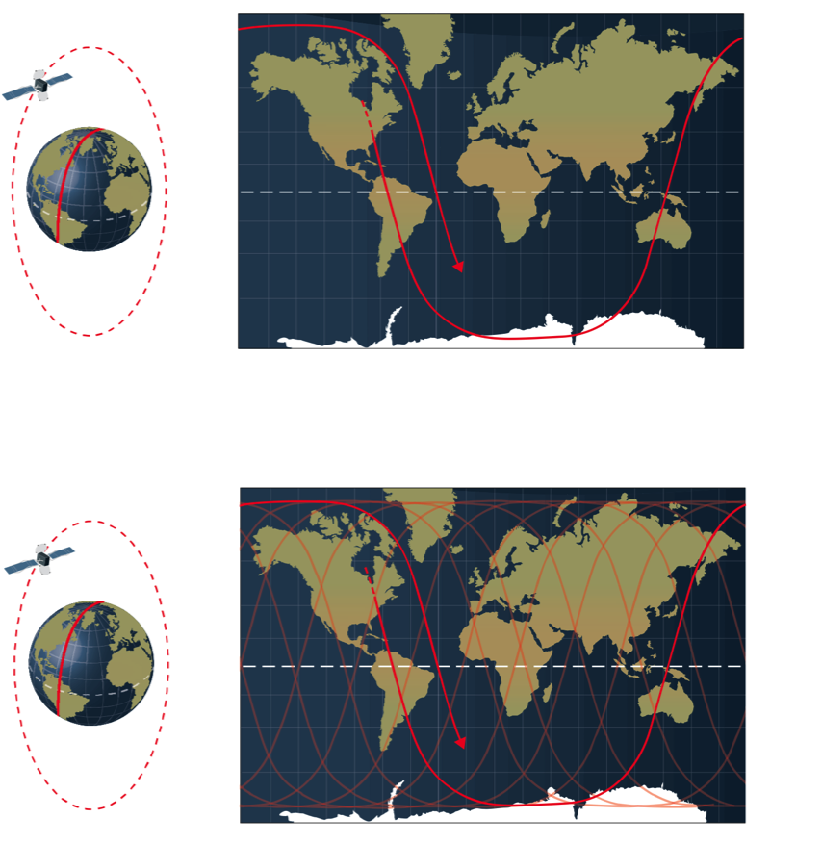
Polar orbit
Notes:
Higher inclination – covers more of the Earth’s surface (less frequently).
Odd shape of curve is an artifact of the map – there isn’t a ‘straight line’ leg either at the poles or on the north-south legs.

Slide 28
Multiple Orbits
Notes:
This orbit is very high inclination – note that it overflies almost everywhere on Earth. Only a polar orbit can do this (which is why it is favoured for reconnaissance).

Slide 29
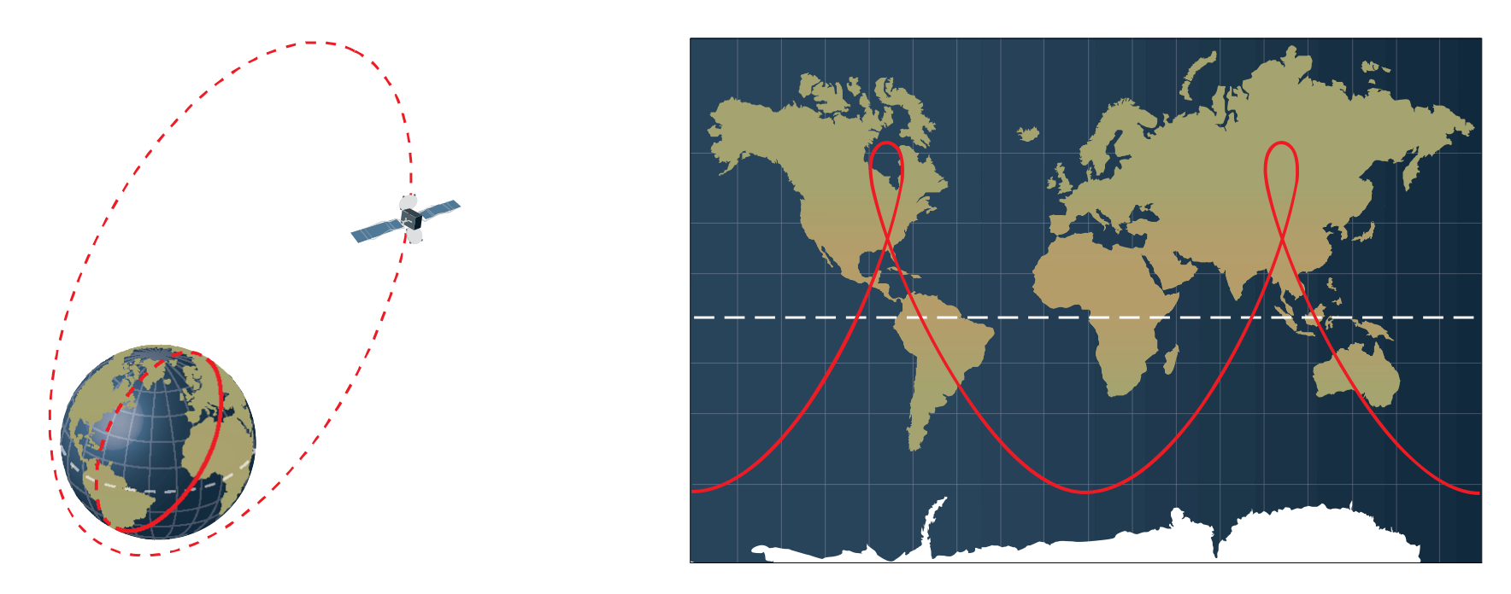
Highly Elliptical Orbit (HEO)
Notes:
More going on than meets the eye!
This example, t=12 hours – semi-synchronous and a repeating ground track.
Speed of satellite varies radically around the orbit (Kepler 2)
The ‘slow’ bits are in the N Hemisphere in this example – long dwell time over Canada and Russia
Inclination (about 63 degrees) is no accident (though we won’t say too much about why) – note it still governs coverage by latitude. It also ensures stability.

Slide 30
GEO
Notes:
Recall our simple equatorial orbit. Ground track lies along the equator
As altitude/radius increases, period lengthens, apparent speed reduces.
At t=24 hrs, satellite appears to be stationary over a point on the equator.
Note only ‘works’ with inclination 0. Otherwise, satellite ‘nods’ north and south (apparent figure of eight over a point on the equator.
Greatest energy to get there. Can’t practically come back.
Good view around equator – but not at poles. Coverage of about 150-160 degrees in longitude.

Slide 31
Missions - LEO
Anything that benefits from being near the Earth’s surface:
Observation – the closer the better (for detail).
Manned spaceflight (for protection from radiation).
Anything that benefits from short periods and potentially overflying all of the Earth’s surface.

Slide 32
Missions - GEO
Anything that benefits from a fixed view of a large part of the Earth’s surface:
Communications and Broadcasting (serve a large ‘market’ or span long distances).
Surveillance (missile warning, weather observation, other environmental monitoring).

Slide 33
Missions - MEO
Anything that benefits from the repeatability of the 12 hr semi-synchronous orbit.
Navigation – the satellites need to have their orbital positions determined periodically.
And the orbit is high enough to ensure stability and uncluttered enough to avoid manoeuvre.

Slide 34
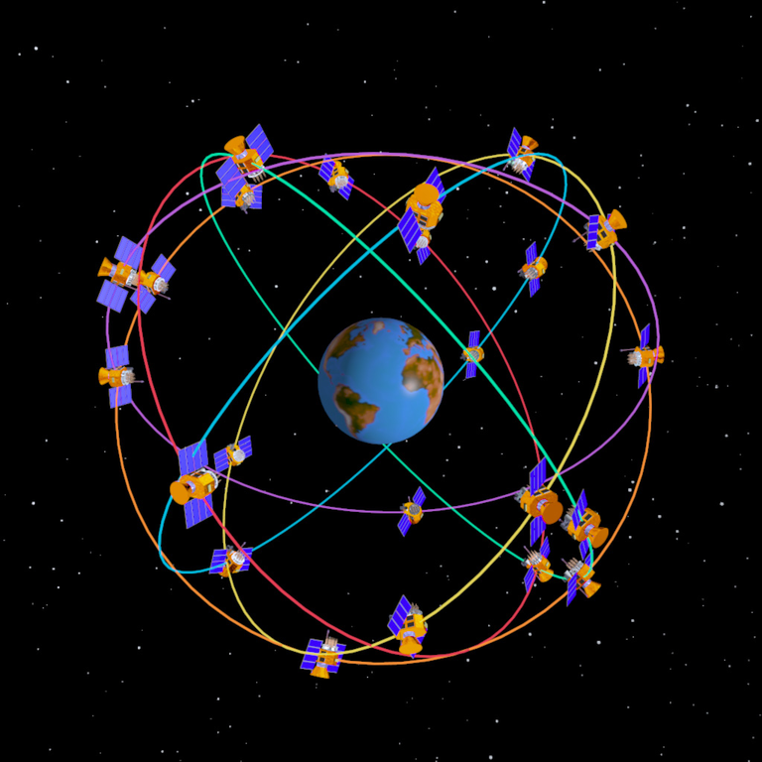
The GPS Constellation

Slide 35
Launch Sites (1)
Launch site constrains orbital inclination.
Inclination at least equal to latitude of launch site – can be more, can’t be less.
So for low inclination (eg geostationary orbit), launch near the equator.

Slide 36
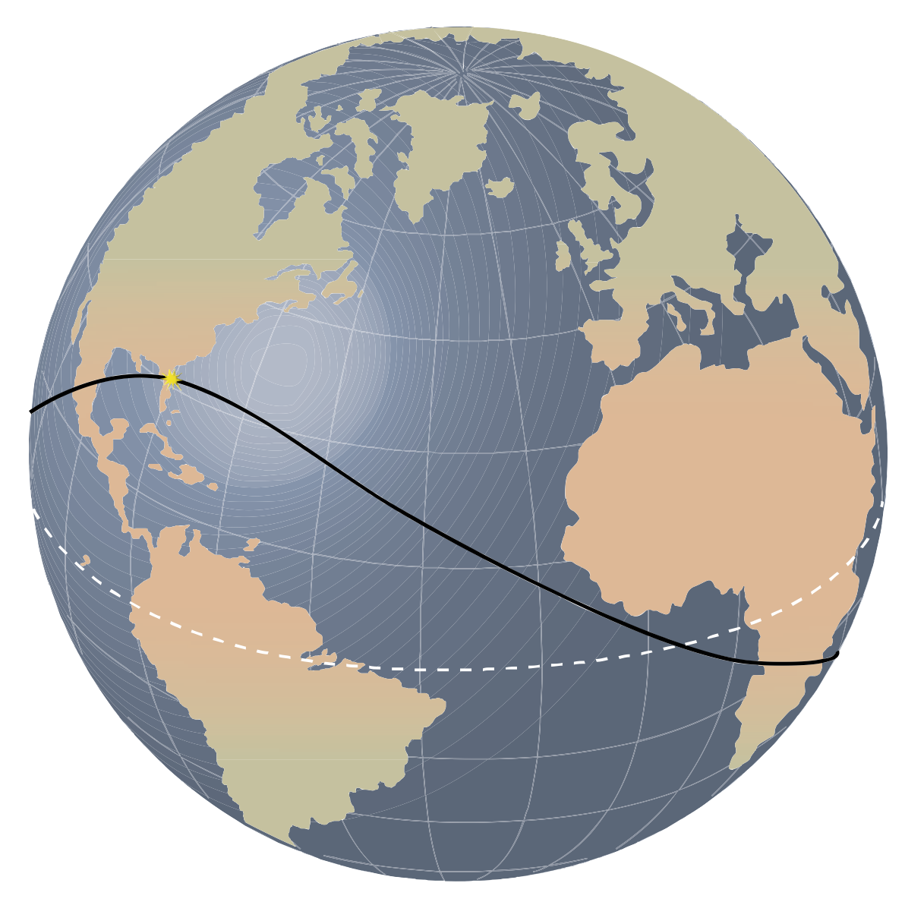
Kennedy Space Center - 28°N
Notes:
All orbits from KSC have at least 28 degrees inclination (from Kepler 1) – the satellite will be in orbit quite near the launch site, and will be roughly that distance from the equator entering orbit.

Slide 37
Launch Sites (2)
Launch hazards – fuel risk / explosion at launch – degree of isolation desirable.
Launch hazards – failure in initial fly-out or planned recovery/jettison of components – need safe impact area.

Slide 38
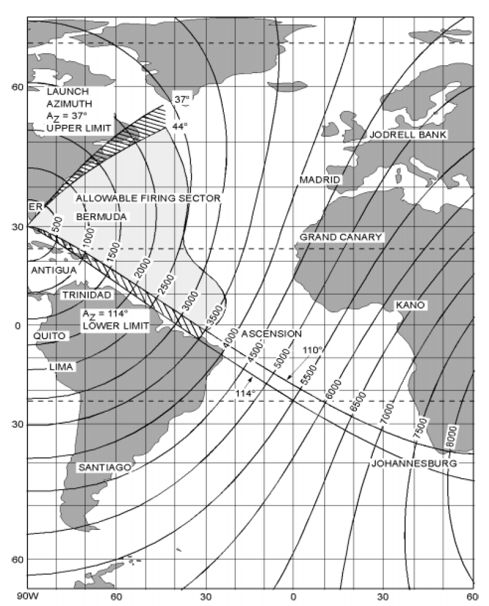
KSC Range Safety
Notes:
Constraints of KSC geography – need to launch over water for safety (not just Space Shuttle, though that was a clear case – SRB recovery). So track constrained by Caribbean and N coast of S America to south, and by Eastern Seaboard and Nova Scotia/Newfoundland to the north.
Rules out reaching polar orbit from KSC – would overfly mid-west or rest of Florida, depending on direction. US polar launches from Vandenberg AFB, California, where there is a clear south-facing track over the Pacific.
NB this is a safety constraint – there is no dynamic reason why you could not launch into a polar orbit from KSC.

Slide 39
Launch Sites (3)
For equatorial orbits, there are performance advantages in launching from a site at low latitudes.
Meet constraints on latitude v inclination.
The rotation of the Earth provides ‘free’ velocity (speed in the correct direction). This can permit use of a smaller launcher, or carriage of an increased payload.
Kourou, French Guiana (3°S) is a good example.

Slide 40
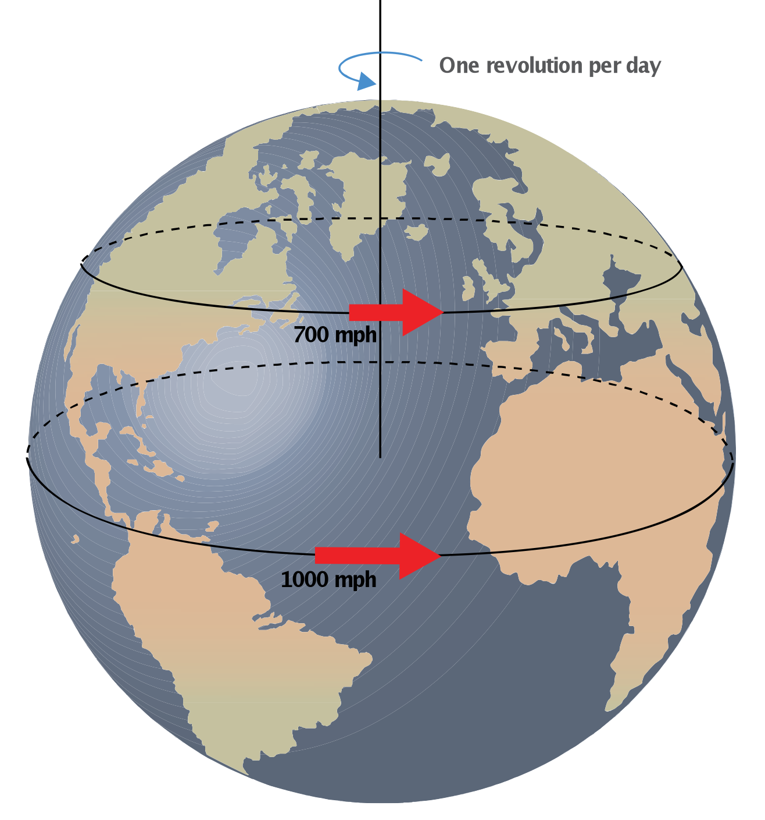
Launch Sites (3)
Notes:
For GEO (or other equatorial orbits), gain about 1000 mph of initial velocity from Earth rotation – significant bonus for payload

Slide 41
Conclusions
‘Practicality of orbit’ is a pragmatic definition of space.
Orbital motion is a combination of horizontal velocity and vertical acceleration towards (the centre of) the Earth.
Kepler’s Laws have concrete consequences for spaceflight.
The combination of orbit type, altitude and the resulting ground track facilitate the various satellite missions.
Launch site constraints have significant implications for achievable orbits.

Slide 42
Thank you for your attention!
Any questions?

Slide 43
Further questions and correspondence welcomed
gerry.doyle@raytheon.co.uk
gerry_doyle83@hotmail.com
07964 139231

